Slide 1
Generative Artificial Intelligence in Legal Education and Law Practice
Festival of Legal Learning
February 2, 2024

Slide 2
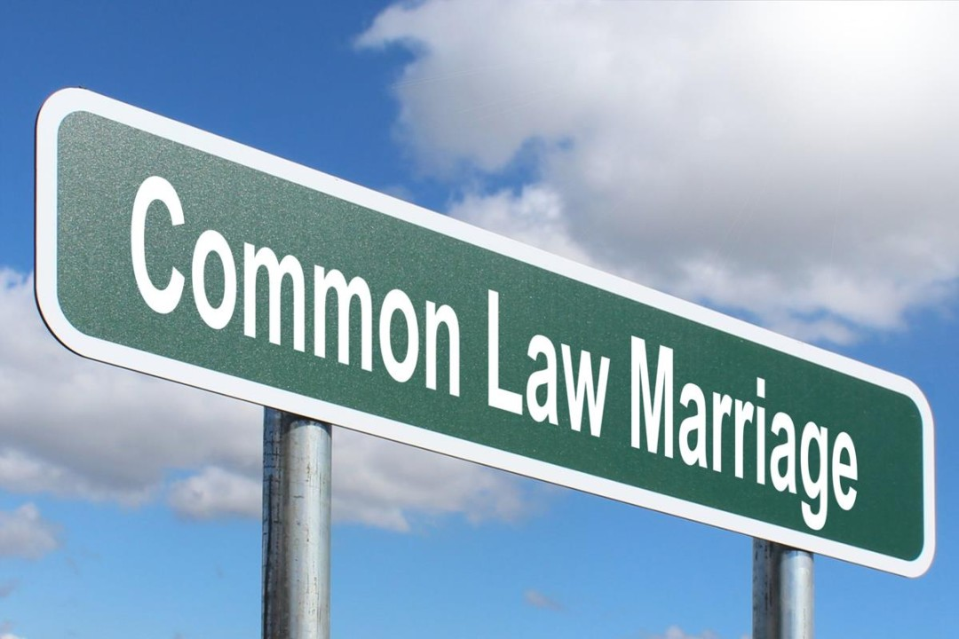
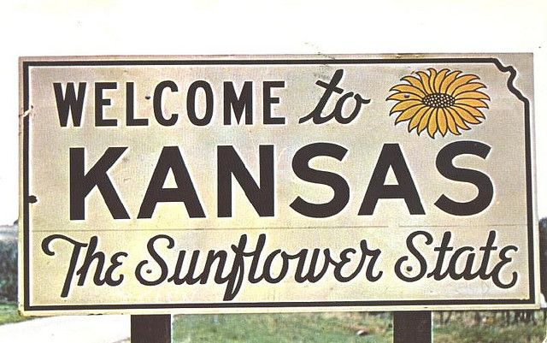
Single-Case Analysis

Slide 3
Single-Case Analysis
Things ChatGPT Did Well
Wrote a decent summary of the KS SC case.
The quality of the writing was very good.
Mostly stayed focused on the “holding out as married” element of CLM, like I asked it to.
Did a good job in the Application section of supporting its points with specific references to Sullivan v. Sullivan.
Notes:
-For the SCA, students only analyze one of the three elements of CLM in KS—whether or not the couple mutually held out or presented themselves as married to their community.
-The other two elements are capacity to enter into a marriage and a present marriage agreement.

Slide 4
Single-Case Analysis
Things ChatGPT Did Poorly
Issue-spotting was incomplete.
Some hallucinating—more on this later!
Occasionally ChatGPT will say something weird because it’s trying to sound lawyerly: “In analyzing A&A’s situation, the mutual holding out requirement becomes central.”
Also makes errors that no human would make: C1 “yes holding out” C2 “no holding out.”
Notes:
-There were some key factors from the Sullivan case that ChatGPT neglected to mention.
-Similarly, there were some important facts about the couple in the students’ hypothetical that ChatGPT failed to consider in its analysis.
-Re: “the mutual holding out requirement becomes central,” mutual holding out is literally the only issue I asked ChatGPT to analyze. So ChatGPT is kind of saying, “look at me, I identified the central issue here,” and I’m like, no, I did that and I told you.
-I’ve been using this assignment for five years, and I’ve never had a student write “A&A satisfy the mutual holding out requirement” on page 1 and then write “A&A do not satisfy” at the end of the paper, but that’s what ChatGPT did.

Slide 5
Single-Case Analysis
Student
“Here, Austin and Ashly were similarly inconsistent in how they presented the nature of their relationship publicly.”
ChatGPT
“In analyzing the circumstances surrounding Austin and Ashly within the framework of Sullivan v. Sullivan, the mutual holding out requirement becomes central.”
Notes:
-I teach my students to use C-RAC to organize their analysis: Conclusion, Rule, Application, Conclusion.
-This slide shows the first sentence of the student’s Application section and the first sentence of ChatGPT’s Application.
-The student’s is much better because as the reader, I can see where the student is going with his analysis.
-I can see that he’s going to conclude NO HOLDING OUT, and he’s going to base his conclusion on inconsistency, which is good because Sullivan also talks about inconsistency.
-With ChatGPT, the sentence doesn’t tell me much of anything. It tells me that ChatGPT is going to focus its analysis on the holding out requirement, but again, that’s what I told it to do.
-In other words, ChatGPT is saying “I’m going to analyze holding out now,” to which my reaction is, “I know, just do it already. Stop telling me you’re going to do it and do it.”

Slide 6
Single-Case Analysis
Sullivan v. Sullivan
“Being aware of the fact that Henry and Hazel were living together, his children, as well as a nephew, asked Henry at different times whether or not he and Hazel were married and received profanely punctuated negative responses.”
ChatGPT
“the court was troubled by Henry's occasional introduction of Hazel as ‘Hazel Walden’ and, notably, his evasive responses when family members directly inquired about their marital status. When asked if they were married, Henry would often respond cryptically, ‘What do you think?’”
Notes:
-Sullivan v. Sullivan is a Kansas Supreme Court case from 1964 on the topic of common-law marriage.
-The first thing I want you to notice is how wrong ChatGPT got this.
-The case says “profanely punctuated negative responses.” In other words, when Henry Sullivan’s relatives would ask him whether he and Hazel were married, he would say “hell no.”
-ChatGPT says Henry would give evasive responses and that he would often respond cryptically, “what do you think?”
-Having read the entire opinion, I can tell you, there is absolutely nothing in the opinion that supports the assertion of evasive responsive or “what do you think?” The words “what do you think” do not appear anywhere in the opinion.
-What makes this even more troubling is that ChatGPT is not going off of its own understanding of the Sullivan case here.
-I literally copied and pasted every single word of the Sullivan opinion into my conversation with ChatGPT, and it still got it wrong.
-Last thing on this, if you try to call ChatGPT out on this, if you ask it something like “where in the opinion does Henry say ‘What do you think?’” ChatGPT will say something like, “well, I’m just an AI ChatBot, I don’t actually have access to the Sullivan opinion.”
-And that’s very frustrating. Don’t tell me you don’t have access to the opinion. I literally just gave you every single word of the opinion two minutes ago.

Slide 7
Single-Case Analysis
Furthermore, their selective approach—referring to themselves as "engaged" around their parents and Ashly mentioning her “fiancé Austin” to unmarried clients—might raise questions about the clarity and consistency of their mutual holding out. While they don't overtly contradict their marital status in the way Henry did in the Sullivan case, the fact that they change how they refer to each other based on their audience could be viewed as not meeting the clear and consistent "mutual holding out" requirement as emphasized in the Sullivan decision.
Notes:
-Last point on the SCA.
-In my experience, ChatGPT and the other LLMs I’ve tried are very indecisive. They don’t want to reach a firm conclusion.
-The assignment was to analyze whether Austin and Ashly satisfy the mutual holding out requirement under Sullivan v. Sullivan, and ChatGPT basically refused to reach a conclusion.
-With ChatGPT there’s always a lot of “on the other hand” and “however,” and it is actually quite good at presenting both sides of an issue.
-But it’s hard to get the program to reach a conclusion.

Slide 8

Client Letter

Slide 9
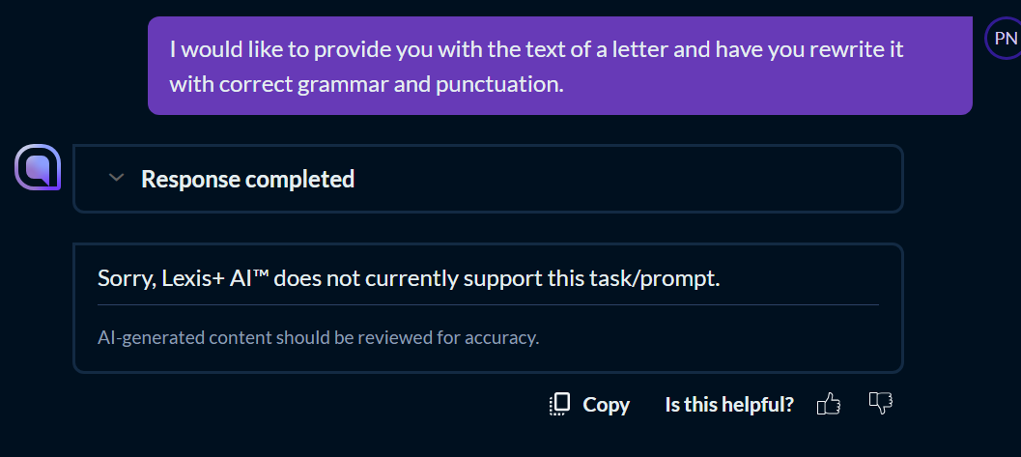
It could be worse…

