Slide 1
Generative AI in Legal Education & Practice
Festival of Legal Learning – February 2, 2024
Nicole Downing
Assistant Director for Public Services
Clinical Associate Professor of Law

Slide 2
ChatGPT versus
Legal Generative AI Tools

Slide 3
Examples of GenAI Tools for Law Practice
LexisNexis
Lexis+ AI
Thomson Reuters
Westlaw Ask Practical Law AI
Casetext - CoCounsel
Vlex - VincentAI
Harvey.ai
LawDroid - CoPilot
Descrybe.ai
Midpage
Paxton.ai
Disco - Cecilia
Relativity
In-House AI

Slide 4
ChatGPT versus Legal GenAI Tools
ChatGPT
Legal Gen AI Tools
Pros:
Free to Use
Easy to Operate
Practical Content Generated
Cons:
Unreliable
Hallucinations
Currency
Lack of Access to Legal Information
Bias
Security & Confidentiality
Extractive versus Generative AI
Pros:
Access to Legal Information
Authoritative & Current
Retrieval-Augmented Generation (RAG)
Easy to Operate
Trained to complete specific tasks*
Cons:
Expensive
User Training Needed for Optimal Output
Developing Technolgy

Slide 5
Prompt Engineering

Slide 6
Prompt Engineering Basics
Create clear instructions.
Set parameters.
Provide examples.
Add context.
Ask follow-up questions or prompts.
SOURCE: Joe Regalia, “ChatGPT and Legal Writing: The Perfect Union?” WRITE.LAW (last visited October 30, 2023).

Slide 7
Prompt Engineering: Legal GenAI
Tone
Role
Output
Issue
Refinement
SOURCE: Jennifer Wondracek, “Prompting Worksheet: Legal AI”, ABA Techshow 2024.

Slide 8
Prompt Engineering: Lexis+
Prime
Include context with your prompt
Persona
Share your desired personality, background, & tone to shape the output
Prompt
Be sure to give clear and specific instructions
Product
Polish
Specify what output you want back from the system as output
Elaborate, refine, verify through the conversation with the system
SOURCE: Lexis+ AI, “Guide to Effective Prompting”, November 10, 2023.

Slide 9
Live Demo: Lexis+ AI &
Westlaw Ask Practical Law AI

Slide 10
Integration of GenAI into the Law School Curriculum

Slide 11
Importance of Teaching GenAI to Law Students
“As educators and legal professionals, we must stay current with emerging technologies and adapt our methods accordingly. The future of legal assignments may indeed change, but the importance of analytical skills and adaptability will remain a cornerstone of the profession.”
-Sarah Gotschall, “Chat GPT-4 Aced the Bar Exam and the Bing Chat Waitlist is No More: Did the Future of Legal Research Just Arrive Today to Make Us Fact Checkers?” RIPS Law Librarian Blog (March 16, 2023).

Slide 12
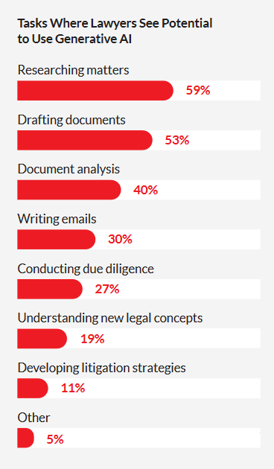
Law Student Use of GenAI
Research
Brainstorming
Issue Spotting
Summarizing
Drafting
Outlines
Starter Text
Editing
Improve & refine
**Law student use of Legal GenAI is limited by academic access to these expensive tools.
-LexisNexis, General AI & the Legal Profession: 2023 Survey Report

