Slide 1
Dragging the Law School Forward: Lucius Polk McGehee and Harry Woodburn Chase, 1910-1924
9 February 2025 – Festival of Legal Learning
Martin H. Brinkley
Dean and William Rand Kenan, Jr. Distinguished Professor of Law

Slide 2
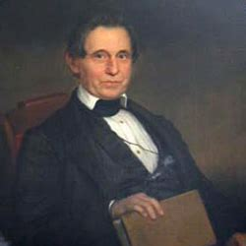
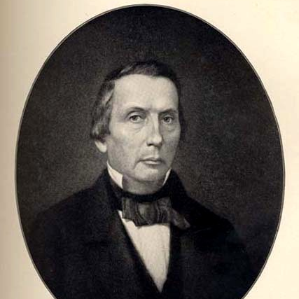

Slide 3
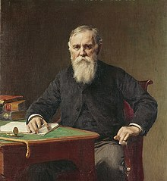
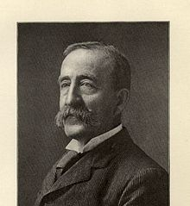

Slide 4
Langdell’s Reforms at Harvard
College degree or entrance examination required for admission
Three years of law study to receive a degree
Examinations (at the end of the year!)
30 hours of instruction per week

Slide 5
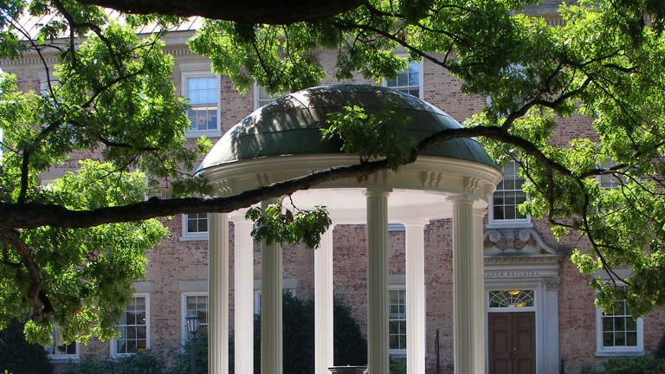
This Photo by Unknown Author is licensed under CC BY-NC-ND

Slide 6
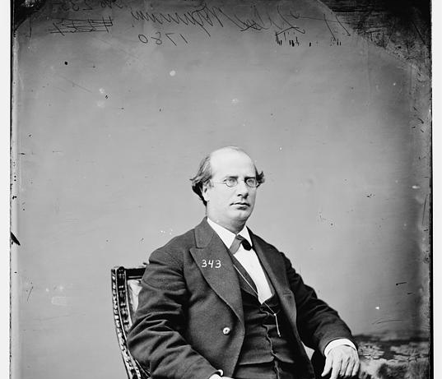
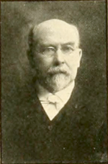

Slide 7
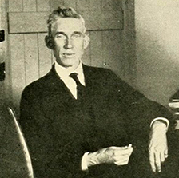
THE FIRST ”MODERN” DEAN: Lucius Polk McGehee (1868-1923)
UNC Class of 1887
UNC Law Class of 1891
Professor of Law, 1904-1910
Dean, UNC School of Law, 1910-1923

Slide 8
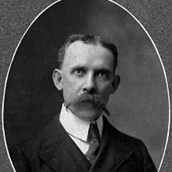
Francis Preston Venable
(1856-1934)
9th President, University of North Carolina (1900-1914)

Slide 9
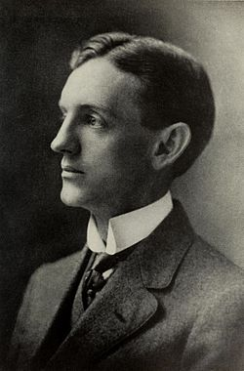
Edward Kidder Graham (1876-1918)
Faculty member and Dean, College of Liberal Arts, UNC (1899-1914)
10th President, University of North Carolina (1914-1918)

Slide 10
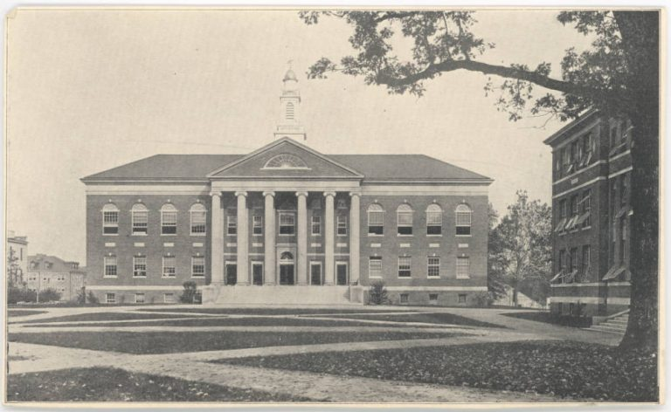

Slide 11
Excerpt from Editorial Notes, 1 N.C. L. Rev. 31 (1922)
“It is hoped that this Review may be of service to the law students, the law teachers, the members of the bar, and to the judges upon the bench, and, through them, to the people of the state. . . .
As a supplement to the routine daily class work of the School, it will afford to the second and third year students, a means of intensive training in legal writing. To them, the independent experience . . . in the analysis, investigation and critical discussion of current problems in North Carolina law will be invaluable. As the Review goes into volumes year by year, it will constitute a collection of reference materials on the local law, of definite value as collateral readings in connection with class discussion.”

Slide 12
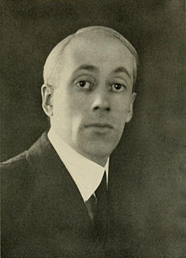
UNC’s ELIOT & LEADER OF THE FORCES OF CHANGE:
Harry Woodburn Chase (1883-1955)
UNC Faculty (1910-1919); 11th President, University of North Carolina (1919-1930)
7th President, University of Illinois (1930-1933)
8th President, New York University (1933-1951)

Slide 13
Harry Woodburn Chase: November 1923 Memorandum to Executive Committee of UNC Trustees
“The question at the root of the whole matter is whether it is the function of the University Law School to prepare an inferior brand of lawyers for law as a trade, or whether it shall prepare men for practice and leadership in law as a profession. It cannot do both. It is no answer to say that great professional success has been attained by men with little legal training. Times have changed. Not only has the existing body of law grown enormously, but the whole social and economic life of North Carolina is rapidly undergoing a transformation which affects legal problems as it affects problems in every other sphere of life. I submit, therefore, that we must choose between a law school which is frankly a coaching school for bar examinations and a real professional law school in the modern sense. To choose the former means to abandon all thought of leadership.”

Slide 14
Harry Woodburn Chase: November 1923 Memorandum, cont’d
“To choose the [path of leadership] is a task calling for an administrative head who knows legal education, who has been trained in modern methods, and who has the youth and vigor to give himself to a grinding task – to a task of building, not of perpetuating a condition which exists. . . . It is my firm conviction that we should, for our dean, go to some other law school and pick a man familiar with the type of capacity in the type of administrative problems he will have to solve here . . . and that we then leave him free to make such appointments as he chooses, and hold him responsible for results.”

Slide 15
Edwin A. Alderman (President, Univ. of Virginia), to Harry Woodburn Chase (Mar. 1924)
“Do not permit yourself to be driven into putting any lawyer in your faculty because he is a practitioner, however eminent. Teaching law and practicing law are two different professions. The University of Virginia has never had a great teacher who was a practitioner of any long standing. The thing to do is to catch them young, regardless of whether they had had any practice at the bar, and make teachers of them. Their job is to teach law, not to practice it. The technique of the practice is easily learned.” Intelligent procedure at great American law schools picks out young promising scholarly men and makes teachers of them. I hope Carolina will follow this precedent.”

Slide 16
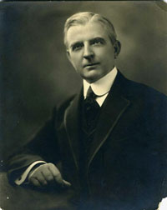
THE OPPOSITION:
Cameron A. Morrison (1869-1953)
Elected Governor of NC as candidate of Simmons Machine in race-baiting campaign, defeating O. Max Gardner (D) and John J. Parker (R)
Governor of NC (1921-1925)
“Good Roads Governor”; opposed teaching of evolution in public schools

Slide 17
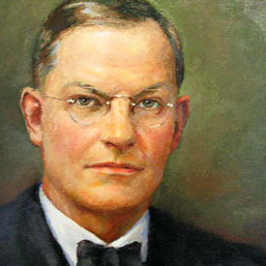
THE COMPROMISE:
Walter P. Stacy (1884-1951)
NC House of Representatives
NC Superior Court
Associate Justice (1920-1925) and Chief Justice (1925-1951), NC Supreme Court

Slide 18
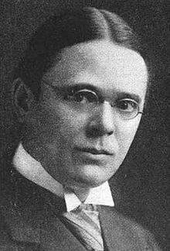
THE CONSULTANT:
Roscoe Pound (1870-1964)
Dean, Harvard Law School
(1916-1936)

Slide 19
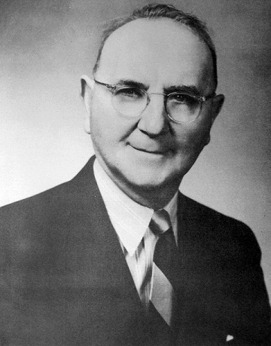
Charles T. McCormick (1889-1963)
LL.B, Harvard Law School
Dean, UNC School of Law
(1927-1931)
Dean, University of Texas School of Law (1940-1949)

Slide 20
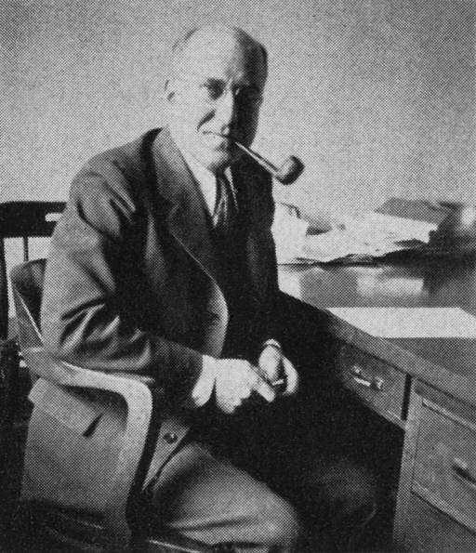
Maurice Taylor Van Hecke
(1892-1963)
LL.B, University of Chicago

Slide 21
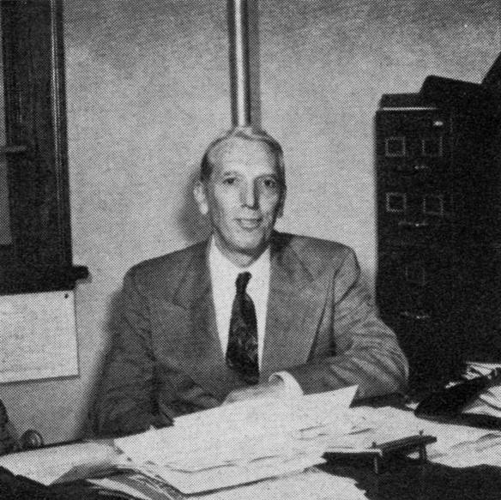
Robert Halsey Wettach (1892-1964)
LL.B, Harvard Law School

