Slide 1
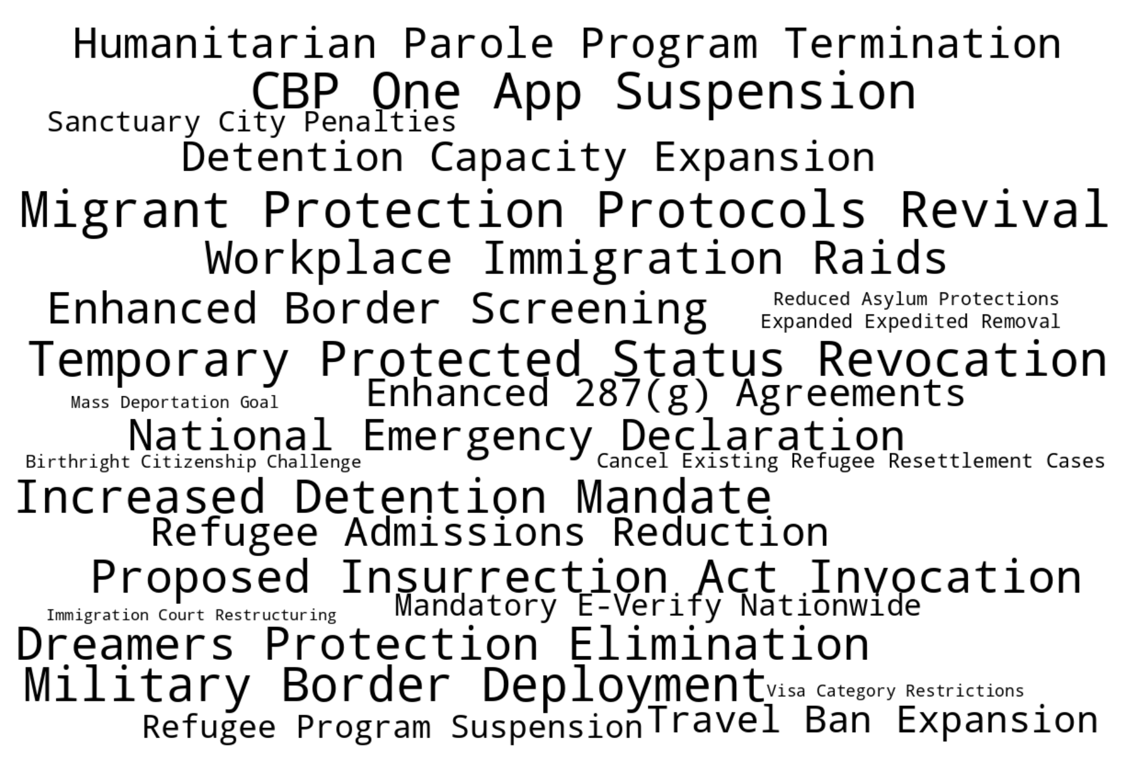
generate a word cloud with the following phrases. keep the phrases intact and oriented left to right. But vary their fonts and size and arrange them all around a landscape page for a powerpoint slide.
National Emergency Declaration
Proposed Insurrection Act Invocation
Migrant Protection Protocols Revival
Expanded Expedited Removal
Enhanced 287(g) Agreements
Detention Capacity Expansion
CBP One App Suspension
Mass Deportation Goal
Dreamers Protection Elimination
Temporary Protected Status Revocation
Visa Category Restrictions
Refugee Program Suspension
Humanitarian Parole Program Termination
Birthright Citizenship Challenge
Enhanced Border Screening
Travel Ban Expansion
Refugee Admissions Reduction
Cancel Existing Refugee Resettlement Cases
Mandatory E-Verify Nationwide
Sanctuary City Penalties
Workplace Immigration Raids
Military Border Deployment
Immigration Court Restructuring
Reduced Asylum Protections
Increased Detention Mandate

Slide 2
generate a word cloud with the following phrases. keep the phrases intact and oriented left to right. But vary their fonts and size and arrange them all around a landscape page for a powerpoint slide.
National Emergency Declaration
Proposed Insurrection Act Invocation
Migrant Protection Protocols Revival
Expanded Expedited Removal
Enhanced 287(g) Agreements
Detention Capacity Expansion
CBP One App Suspension
Mass Deportation Goal
Dreamers Protection Elimination
Temporary Protected Status Revocation
Visa Category Restrictions
Refugee Program Suspension
Humanitarian Parole Program Termination
Birthright Citizenship Challenge
Enhanced Border Screening
Travel Ban Expansion
Refugee Admissions Reduction
Cancel Existing Refugee Resettlement Cases
Mandatory E-Verify Nationwide
Sanctuary City Penalties
Workplace Immigration Raids
Military Border Deployment
Immigration Court Restructuring
Reduced Asylum Protections
Increased Detention Mandate
Recent Developments in Immigration Law
UNC Festival of Legal Learning 2025
Rick Su

Slide 3
Outline
Legal Immigration Categories
Military and Immigration Enforcement
Local Enforcement and Sanctuary Cities
Birthright Citizenship
The Laken Riley Act (2025)

Slide 4
Legal Immigration Categories
Admissions per Year in: | 2014 | 2022
Family-Based | 645,000 | 594,000
Employment Based | 152,000 | 270,000
Diversity Visa | 54,000 | 43,000
“Non-immigrants” (Temporary) | 180,000,000 | 181,000,000
Refugee | 70,000 | 25,500
Asylum Grants | 23,533 | 36,600
Total Admitted in Year: | 2014 | 2024
Humanitarian Parole | <10,000* | 1,312,000
Temporary Protected Status | 340,000 | 886,000

Slide 5
Legal Immigration Categories
Admissions per Year in: | 2014 | 2022
Family-Based | 645,000 | 594,000
Employment Based | 152,000 | 270,000
Diversity Visa | 54,000 | 43,000
“Non-immigrants” (Temporary) | 180,000,000 | 181,000,000
Refugee | 70,000 | 25,500
Asylum Grants | 23,533 | 36,600
Total Admitted in Year: | 2014 | 2024
Humanitarian Parole | <10,000* | 1,312,000
Temporary Protected Status | 340,000 | 886,000

Slide 6
Immigration Categories: Humanitarian
Asylum
Humanitarian Parole
&
Temporary Protected Status
Overseas Refugee Program

Slide 7
Legal Immigration Categories: Other Bans
Admissions per Year in: | 2014 | 2022
Family-Based | 645,000 | 594,000
Employment Based | 152,000 | 270,000
Diversity Visa | 54,000 | 43,000
“Non-immigrants” (Temporary) | 180,000,000 | 181,000,000
Refugee | 70,000 | 25,500
Asylum Grants | 23,533 | 36,600
Total Admitted in Year: | 2014 | 2024
Humanitarian Parole | <10,000* | 1,312,000
Temporary Protected Status | 340,000 | 886,000

Slide 8
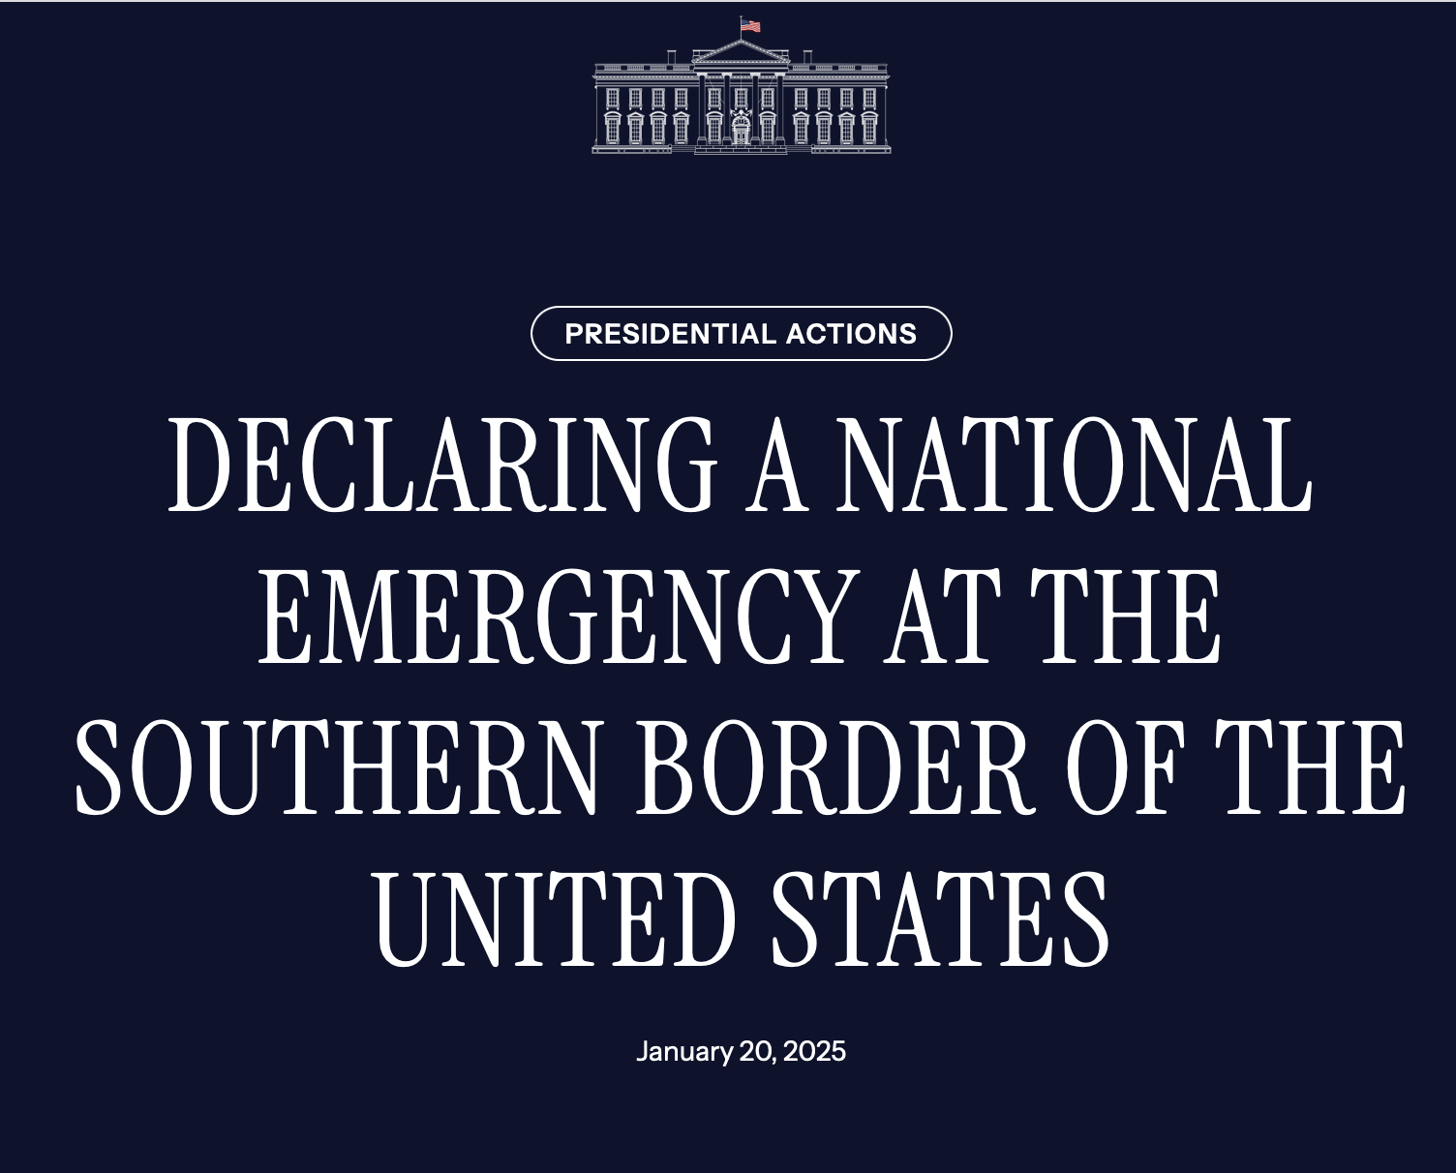
Military and Immigration Enforcement

Slide 9
Military and Immigration Enforcement
Trigger
I . . . hereby declare that a national emergency exists at the southern border of the United States, . . . [and] that this emergency requires use of the Armed Forces.
Immediate Actions
. . . all appropriate action to facilitate the operational needs of the Secretary of Homeland Security along the southern border, including
Detention Space
Transportation (including aircraft)
Physical Barriers
“[I]mpedance and denial of the unauthorized physical entry”
Ongoing Role
. . . revision to the Unified Command Plan that assigns United States Northern Command (USNORTHCOM) the mission to seal the borders and maintain the sovereignty, territorial integrity, and security of the United States by repelling forms of invasion including unlawful mass migration, narcotics trafficking, human smuggling and trafficking, and other criminal activities.

Slide 10
Local Enforcement and Sanctuary Cities

Slide 11
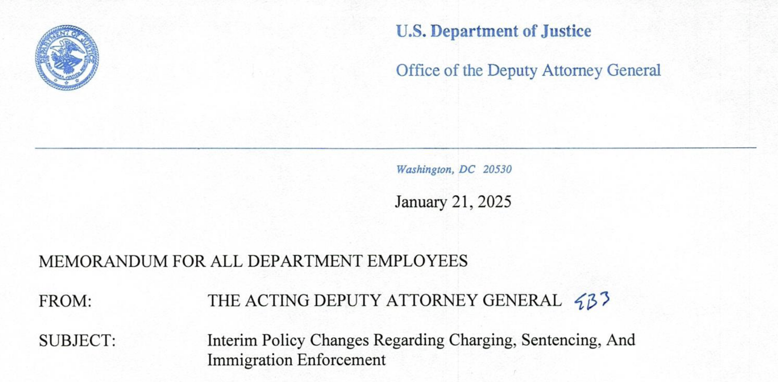
Local Enforcement and Sanctuary Cities
Sec. 17. Sanctuary Jurisdictions.
. . . “sanctuary” jurisdictions, which seek to interfere with the lawful exercise of Federal law enforcement operations,.
Federal law prohibits state and local actors from resisting, obstructing, and otherwise failing to comply with lawful immigration-related commands and requests . . . .

Slide 12
Local Enforcement and Sanctuary Cities
Federal
“Interfere”
“failing to comply”
Supremacy Clause
“Plenary Power”
Federal Preemption
Federalism
“State Rights”
Anti-Commandeering
State / Local

Slide 13
Birthright Citizenship
Sec. 2. Policy.
(a) It is the policy of the United States that no department or agency of the United States government shall issue documents recognizing United States citizenship, or accept documents issued by State, local, or other governments or authorities purporting to recognize United States citizenship, to persons:
when that person’s mother was unlawfully present in the United States . . . or
when that person’s mother’s presence in the United States was lawful but temporary, and the person’s father was not a United States citizen or lawful permanent resident at the time of said person’s birth.

Slide 14
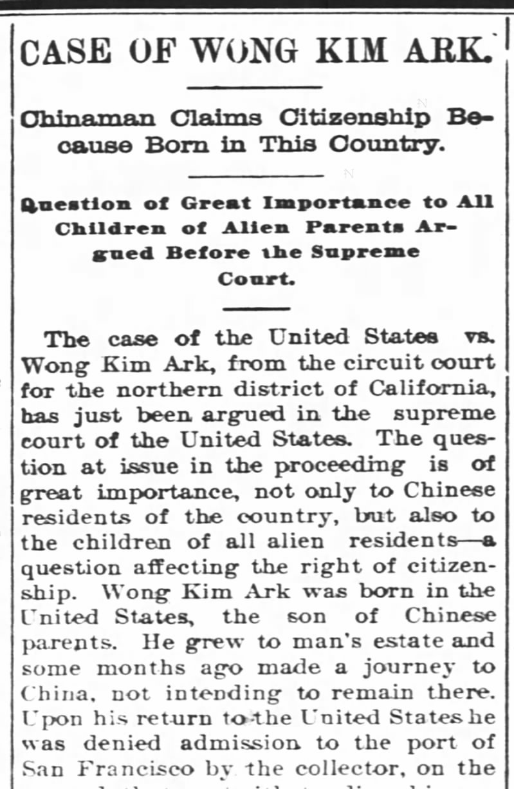
Birthright Citizenship
FOURTEENTH AMENDMENT
Section 1
All persons born or naturalized in the United States, and subject to the jurisdiction thereof, are citizens of the United States and of the State wherein they reside.
United States v. Wong Kim Ark
169 U.S. 649 (1898)

Slide 15
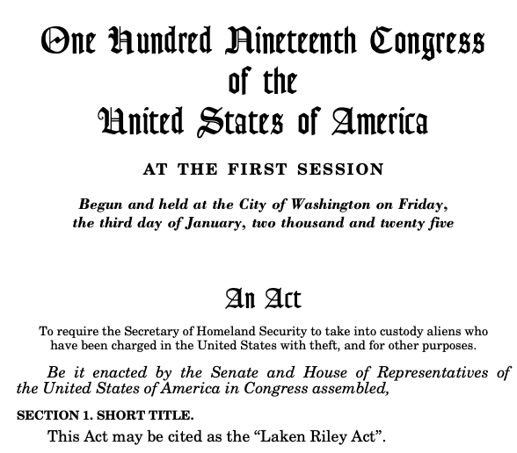
The Laken Riley Act (2025)
SEC. 2. Detention of certain aliens who commit theft.
(3) DETAINER.—The Secretary of Homeland Security shall issue a detainer for an alien described in paragraph (1)(E) and, if the alien is not otherwise detained by Federal, State, or local officials, shall effectively and expeditiously take custody of the alien.”
SEC. 3. Enforcement by attorney general of a State.
The attorney general of a State, or other authorized State officer, alleging a violation of the detention and removal requirements . . . release [of] any alien or grant bond or parole to any alien . . . a violation of the requirement to discontinue granting visas to citizens, subjects, nationals, and residents . . . shall have standing to bring an action against the Secretary of Homeland Security . . . .

