Slide 1
The Shining Traces of His Pen: Jefferson, Tacitus and “Pith”
13 February 2026 – Festival of Legal Learning
Martin Brinkley
William Rand Kenan, Jr. Distinguished Professor
Dean Emeritus

Slide 2
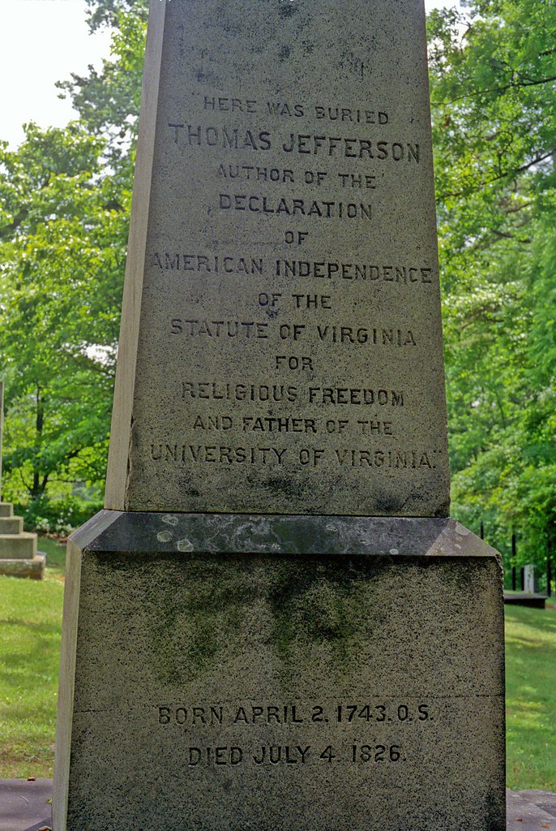
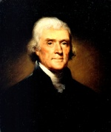

Slide 3
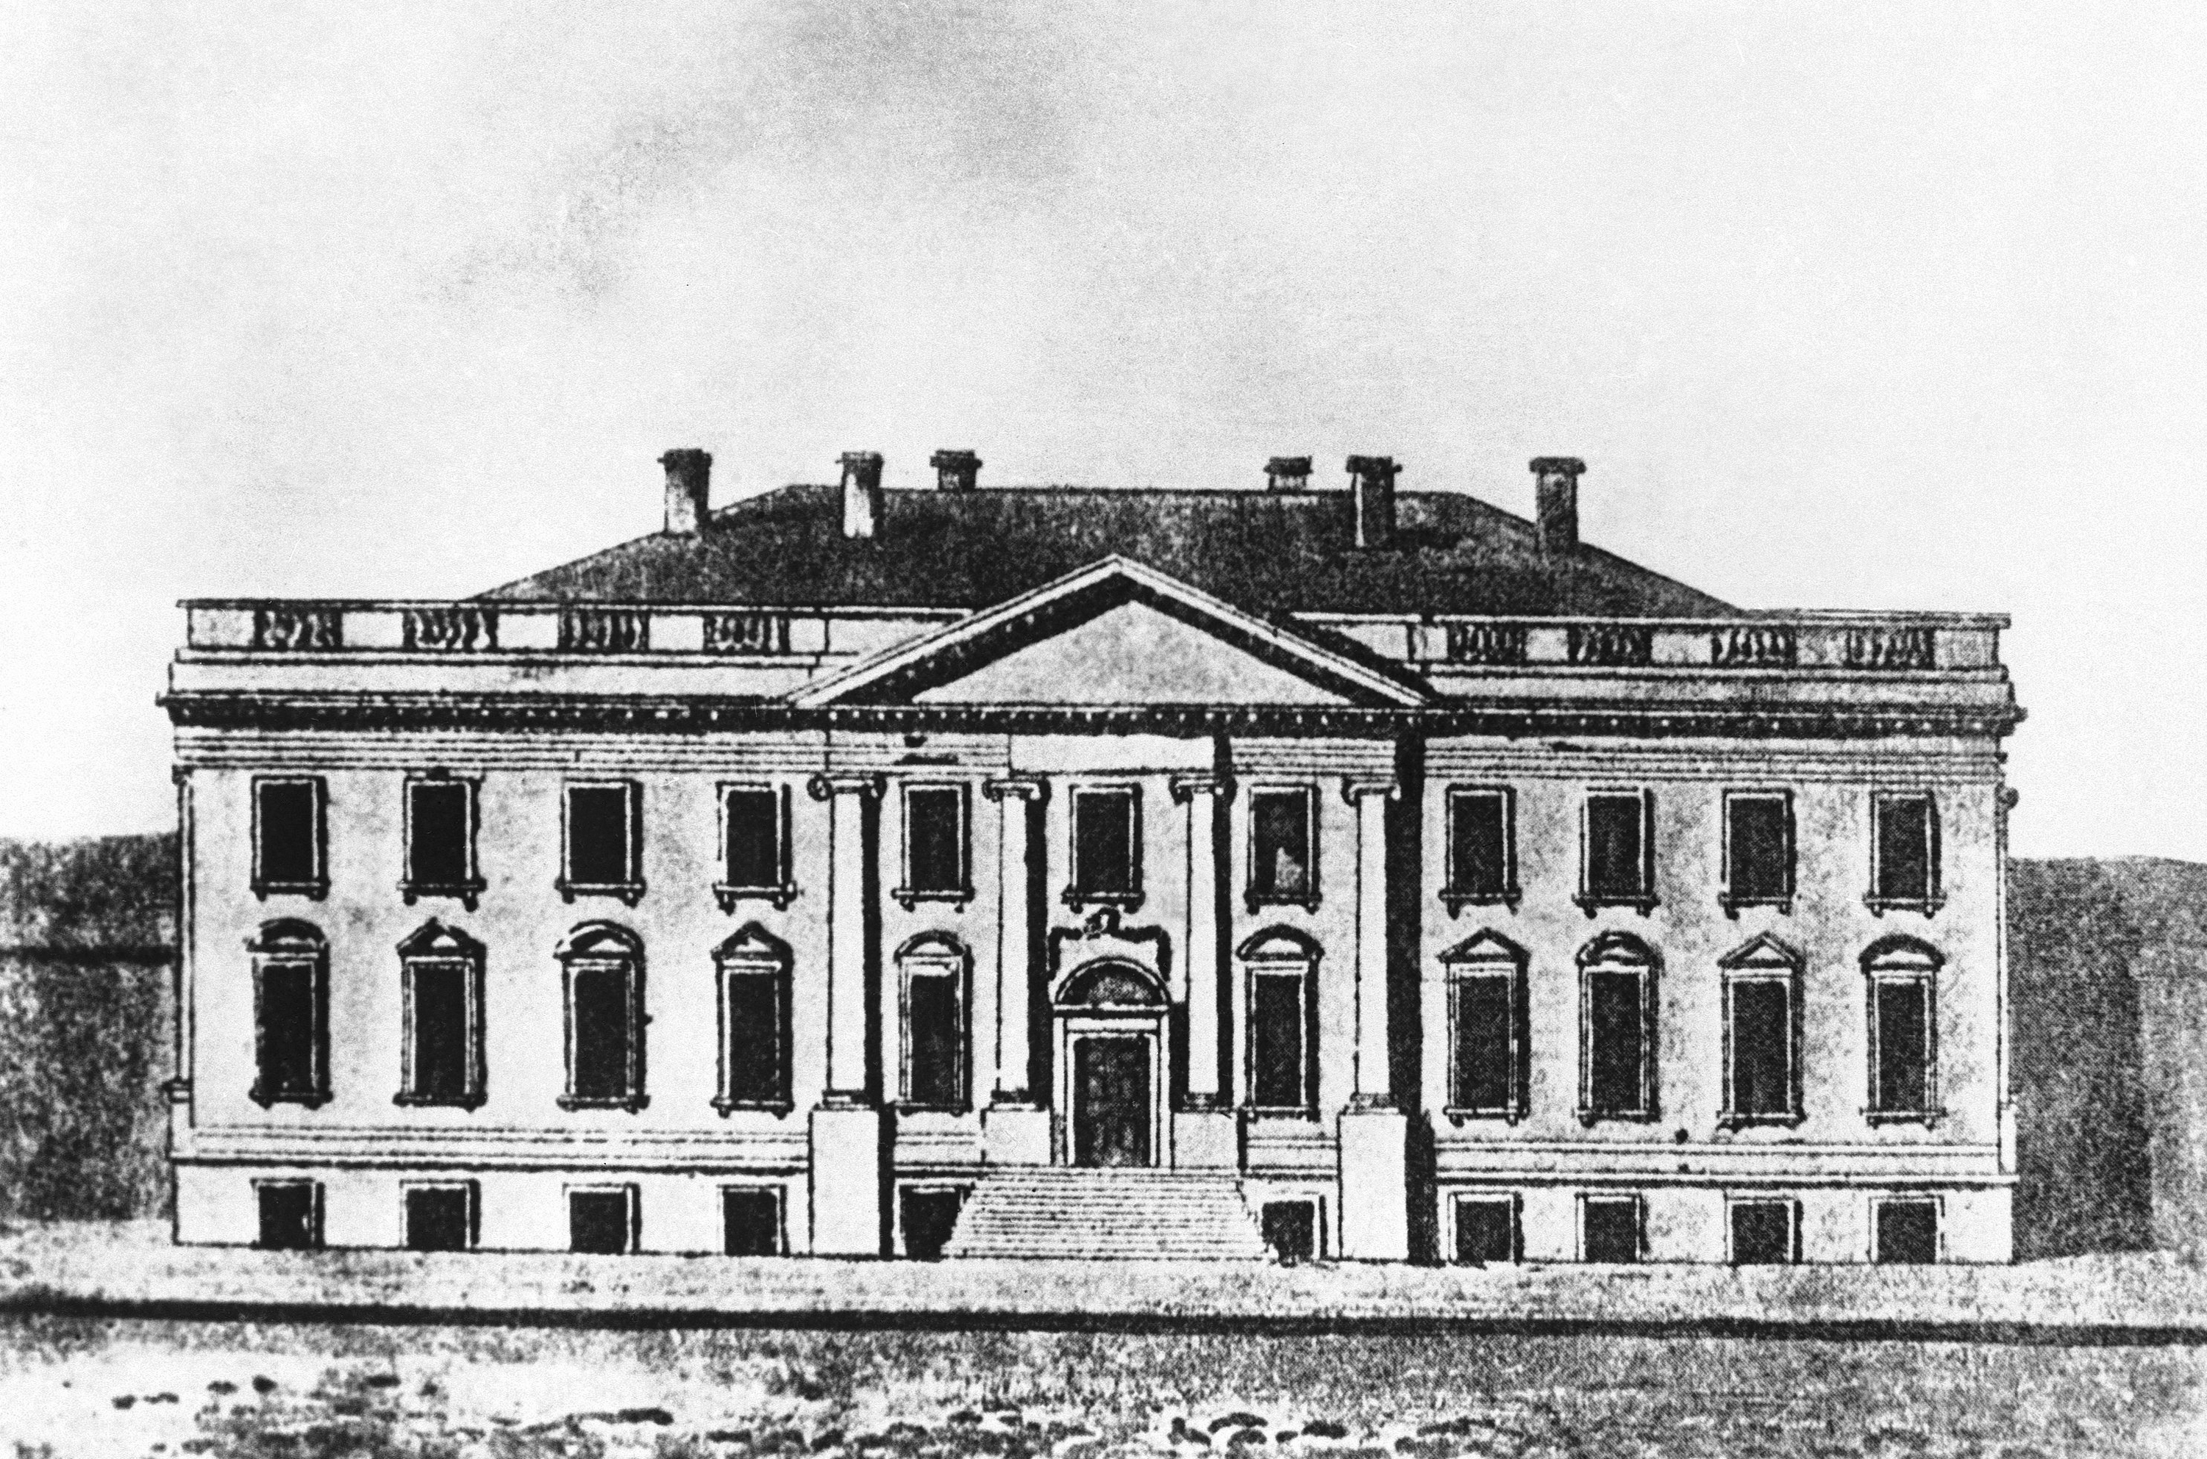

Slide 4
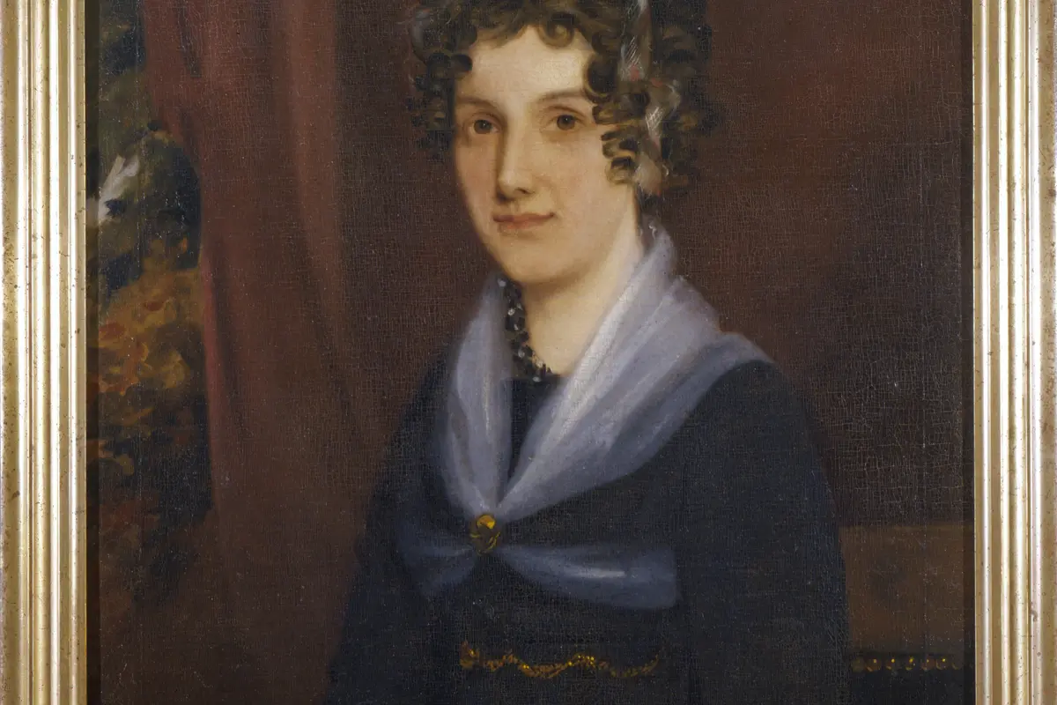
Anne Carey Randolph Bankhead (1791-1826): Thomas Jefferson’s oldest grandchild

Slide 5
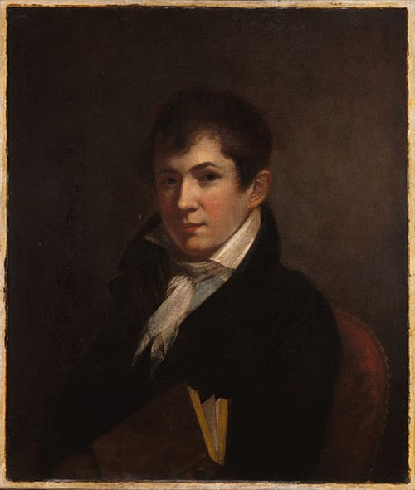
Thomas Jefferson (“Jeff”) Randolph (1792-1875): Anne Carey Randolph Bankhead’s younger brother, Thomas Jefferson’s favorite grandson

Slide 6
I like much your choice of books for your winter’s reading. . . . Tacitus I consider as the first writer in the world without a single exception. his book is a compound of history & morality of which we have no other example.
Thomas Jefferson to Anne Carey Randolph Bankhead, 8 December 1808

Slide 7
No stile of writing is so delightful as that which is all pith, which never omits a necessary word, nor uses an unnecessary one. the finest models of this existing are Sallust and Tacitus, which on that account are worthy of constant study. and that you may have every just encouragement I will add that from what I observe of the natural stile of your letters I think you will readily attain this kind of perfection.
Thomas Jefferson to Thomas Jefferson Randolph, 7 December 1808

Slide 8
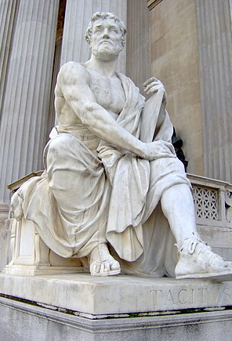
Publius Cornelius Tacitus (AD 56?–120?)
(Statue outside Austrian Parliament Building, Vienna)

Slide 9
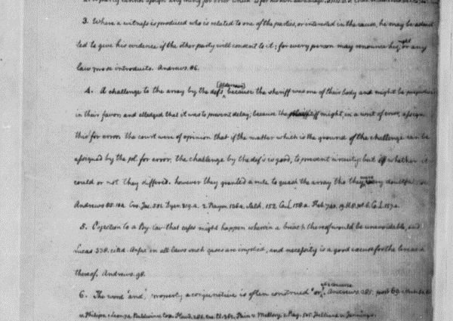
Thomas Jefferson, Legal Commonplace Book, ca. 1770

Slide 10
Principal Works of Tacitus
96 Agricola
98 Germania
100-110 Historiae (originally covered AD 69-96 in 14 books; 4 books survive entire, along with 26 chapters of a fifth book; all cover the year 69-70)
115-120? Annales (originally covered AD 14-68 in 16 books; books 7-10 and parts of books 5, 6, 11 and 16 are missing)

Slide 11
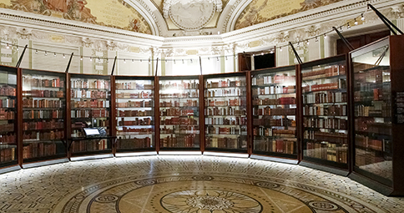

Slide 12
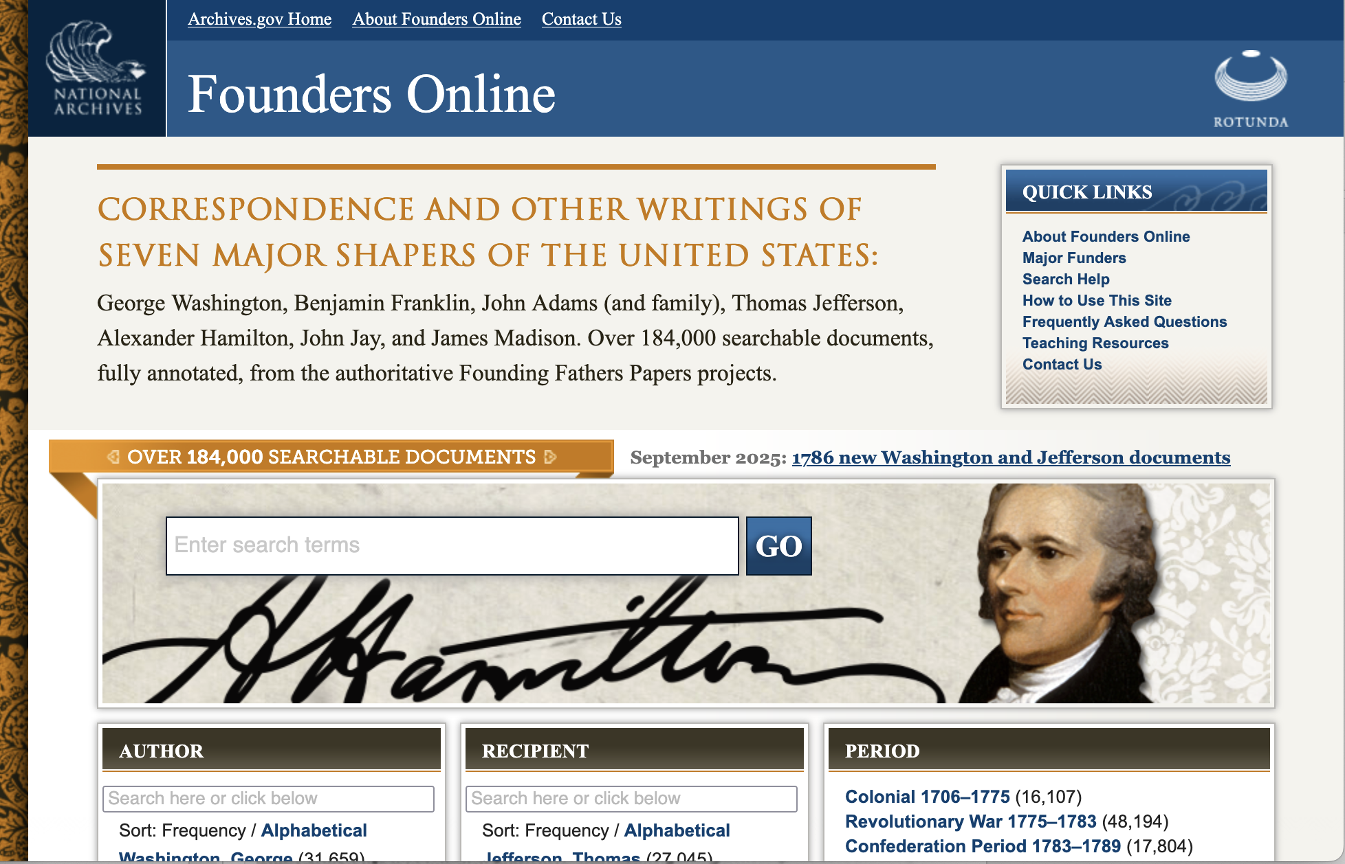

Slide 13
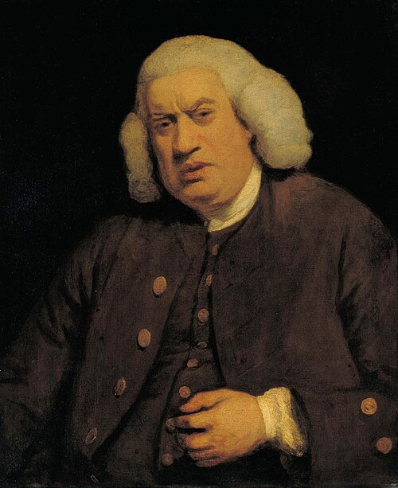
“Pith”: “Energy; cogency; fulness of sentiment; closeness and vigour of thought and st[y]le.”
This Photo by Unknown Author is licensed under CC BY-SA

Slide 14
I acknolege myself at the same time not an adept in the metaphysical speculations of grammar. by analysing too minutely we often reduce our subject to atoms of which the mind loses it’s hold. nor am I a friend to a scrupulous purism of style. I readily sacrifice the niceties of syntax to euphony and strength. it is by boldly neglecting the rigorisms of grammar that Tacitus has made himself the strongest writer in the world. the Hypercritics call him barbarous; but I should be sorry to exchange his barbarisms for their wire-drawn purisms. some of his sentences are as strong as language can make them. had he scrupulously filled up the whole of their syntax, they would have been merely common. to explain my meaning by an English example, I will quote the motto of o[ne,] I believe, of the regicides of Charles I. ‘Rebellion to tyrants is obedience [to] God.’ correct it’s syntax, ‘Rebellion against tyrants is obedience to God,’ it has lost all the strength and beauty of the antithesis. however, dear Sir, I profess again my want of familiarity with these speculations, I hazard them without confidence, and offer them submissively to your consideration and more practised judgment.
(J. to Edward Everett, Feb. 24, 1823)

Slide 15
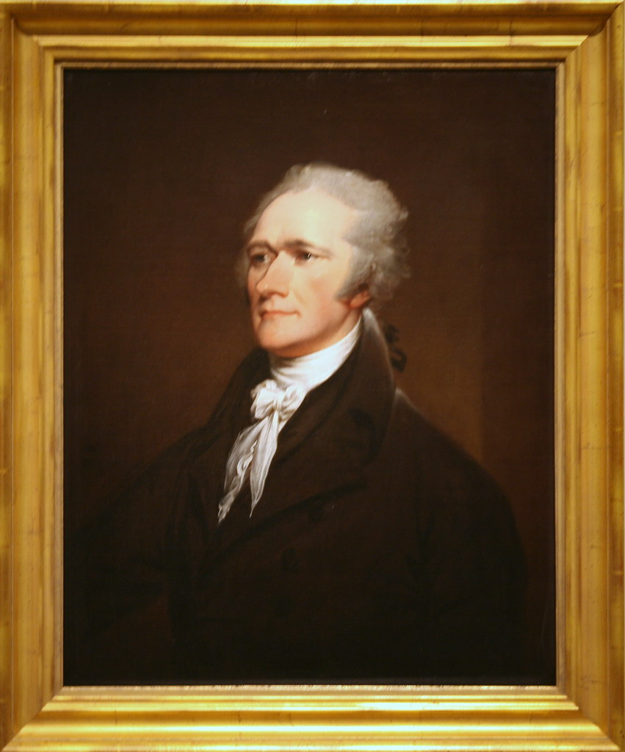
“For god’s sake, my dear Sir, take up your pen, select the most striking heresies, and cut him to pieces in the face of the public. There is nobody else who can & will enter the lists with him. Never in my opinion, was so calamitous an appointment made, as that of the present minister of F. here. Hotheaded, all imagination, no judgment, passionate, disrespectful & even indecent towards the P. in his written as well as verbal communications, talking of appeals from him to Congress, from them to the people, urging the most unreasonable & groundless propositions, & in the most dictatorial style &c.” (J. to James Madison, July 7, 1793)

