Slide 1
Merchant Cash Advances Loans? Sales? Why Does It Matter?
UNC Festival of Learning
February 13, 2026
Prof. Kara Bruce
University of North Carolina
School of Law

Slide 2

Introducing the Merchant Cash Advance (MCA)
Business Cash Advance
Revenue-Based Financing

Slide 3
Agenda
Introduction to MCAs
Brief discussion of bankruptcy/non-bankruptcy issues
Loan v. Sale Characterization
Doctrine
Application
Recent Developments

Slide 4
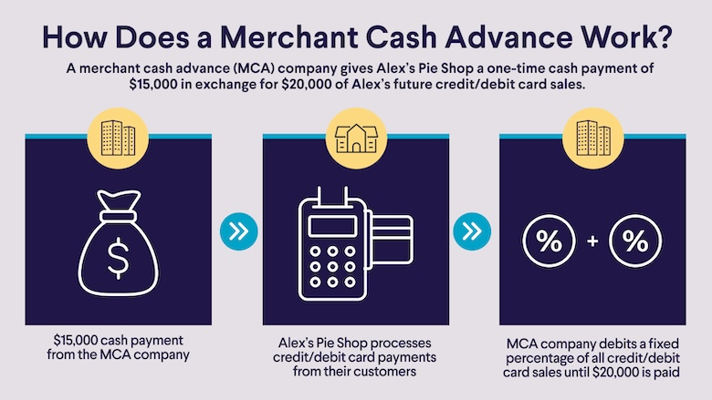

Slide 5
MCA hallmark: reconciliation provision
As long as an Event of Default, or breach of this Agreement, has not occurred, once per calendar month Merchant may request a retroactive reconciliation of the total Remittance . . . [MCA] retains the right to request additional documentation . . . . refusal to provide access shall be a breach of this Agreement and [MCA] shall have no obligation to reconcile.

Slide 6
Advertised Benefits
Drawbacks
Fast cash
Access
Promises of repayment flexibility
Extraordinarily high costs
Daily payments, difficulty adjusting.
Very aggressive enforcement/remedial rights
Snowballing risk

Slide 7
Select Bankruptcy and Non-Bankruptcy Issues
Can the debtor/guarantor defend based on usury?
Are the assigned receivables property of the estate/their proceeds cash collateral?
Are post-bankruptcy drafts by MCA permitted?
Are pre-bankruptcy drafts by MCA preferential?
Are MCA transactions fraudulent transfers?
Is this a loan in disguise?

Slide 8
What rights are transferred? When does this transaction occur?
[Merchant] is selling a portion of a future revenue stream to [Finance Company] at a discount, not borrowing money from [Finance Company].
Notes:
Ipse Dixit

Slide 9



Recharacterization: Sales v. Loans
Loan: Lender is entitled to a fixed repayment
Regardless of how the assets perform
Secured Lender
Accounts Receivable
Sale: Receives more/less depending on how the assets perform.
Seller/ Debtor
Buyer

Slide 10
Factors Commonly Evaluated in MCA Cases
Whether the agreement has a reconciliation provision
Whether the agreement has a finite term
Whether there is any recourse should the merchant declare bankruptcy

Slide 11
[Merchant] is selling a portion of a future revenue stream to [Finance Company] at a discount, not borrowing money from [Finance Company].
Merchant
Account
Account
Account
Account
Account
Account
Account
Account
Account
Account
Account
Account
Account
Account
Account

Slide 12
Updates: Case Law
“Recently, Federal courts have engaged in a more thorough and exacting scrutiny of merchant cash advance agreements, looking at the agreements in a holistic and comprehensive manner and the conclusions they have reached are compelling.”
Hi Bar Capital LLC v. Parkway Dental Services, LLC, 2022 WL 3757589, at *3 (N.Y. Sup. Ct. Aug. 25, 2022) (collecting cases)

Slide 13
How would you evaluate this contract language?
[Merchant] is selling a portion of a future revenue stream to [Finance Company] at a discount, not borrowing money from [Finance Company].
Sale
Neutral
Loan
Notes:
Ipse Dixit

Slide 14
How would you evaluate this contract language?
If Future Receipts are remitted more slowly than [Finance Company] may have anticipated . . . or if the full Purchased Amount is never remitted . . .and Merchant hasn’t breached . . ., [Merchant] would not owe anything to [Finance Company].
Sale
Neutral
Loan
Notes:
Ipse Dixit

Slide 15
How would you evaluate this contract language?
As long as an Event of Default, or breach of this Agreement, has not occurred, once per calendar month Merchant may request a retroactive reconciliation of the total Remittance . . . [Funder] retains the right to request additional documentation . . . . refusal to provide access shall be a breach of this Agreement and [Funder] shall have no obligation to reconcile.
Sale
Neutral
Loan
Notes:
Ipse Dixit

Slide 16
Consider: The Relationship Between the Specified Percentage and Reconciliation.
“The Daily Payment amount is intended to represent the Specified Percentage of Seller's Future Receipts. Seller may request that Purchaser reconcile Seller's actual receipts by either crediting or debiting the difference back to or from the Account . . . .”
Imagine: Debtor’s daily revenue is $20,000.
Daily Amount | Specified Percentage of daily receivables | Merchant can lower payment if
$2000 | 10% (accurate) | Daily revenue falls below $20,000.
$2000 | 15% (inaccurate) | Daily revenue falls below $13,350 (or by 1/3)
Notes:
Some of the most egregious bad actors have adopted a practice of inflating the specified percentage to be far beyond the projected receivables, in an effort to serve as a barrier tor reconciliation. Conider this hypothetical.

Slide 17
How would you evaluate this contract language?
[If any event of default occurs], Purchaser may proceed to enforce its rights including [acceleration], [backup security interests], [personal guaranty].
Sale
Neutral
Loan
Notes:
Ipse Dixit

Slide 18
How would you evaluate this fact?
Does the MCA funder’s filing of a UCC-1 financing statement indicate the transaction is a loan?
Sale
Neutral
Loan
Notes:
Ipse Dixit

Slide 19
Updates –
Case law shift
Regulatory/prosecutorial developments
Rebranding
Twists and turns in choice of law
Commercial Financing Disclosure Laws

Slide 20
Looking forward
Business realities – more MCAs?
Uniform commercial disclosure act
Further development in courts

Slide 21
Discussion & Q&A
kbruce1@unc.edu

