Slide 1
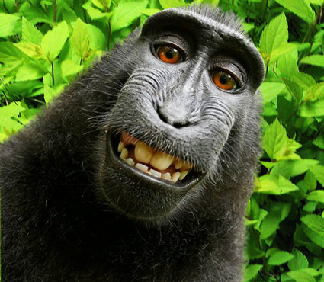

IP Issues and Ownership of AI
Precedent
The Incident: In 2011, Indonesian macaque Naruto took several photos, including selfies, using a camera left unattended by British photographer David Slater.
The Lawsuit: PETA filed a "next friend" lawsuit in 2015 against Slater and his publisher, arguing that Naruto, as the creator, owned the copyright.
Court Ruling: The 9th Circuit affirmed that while the complaint had enough facts for Article III standing, Naruto lacked statutory standing because the Copyright Act does not authorize animals to file copyright suits.
Significance: While Naruto did not win the legal right to own copyright, the case forced a legal discussion on animal rights and legal standing.
by Naruto

