Slide 1

Helene Recovery Update
UNC Law Festival
Mayor Esther Manheimer
February 2026

Slide 2
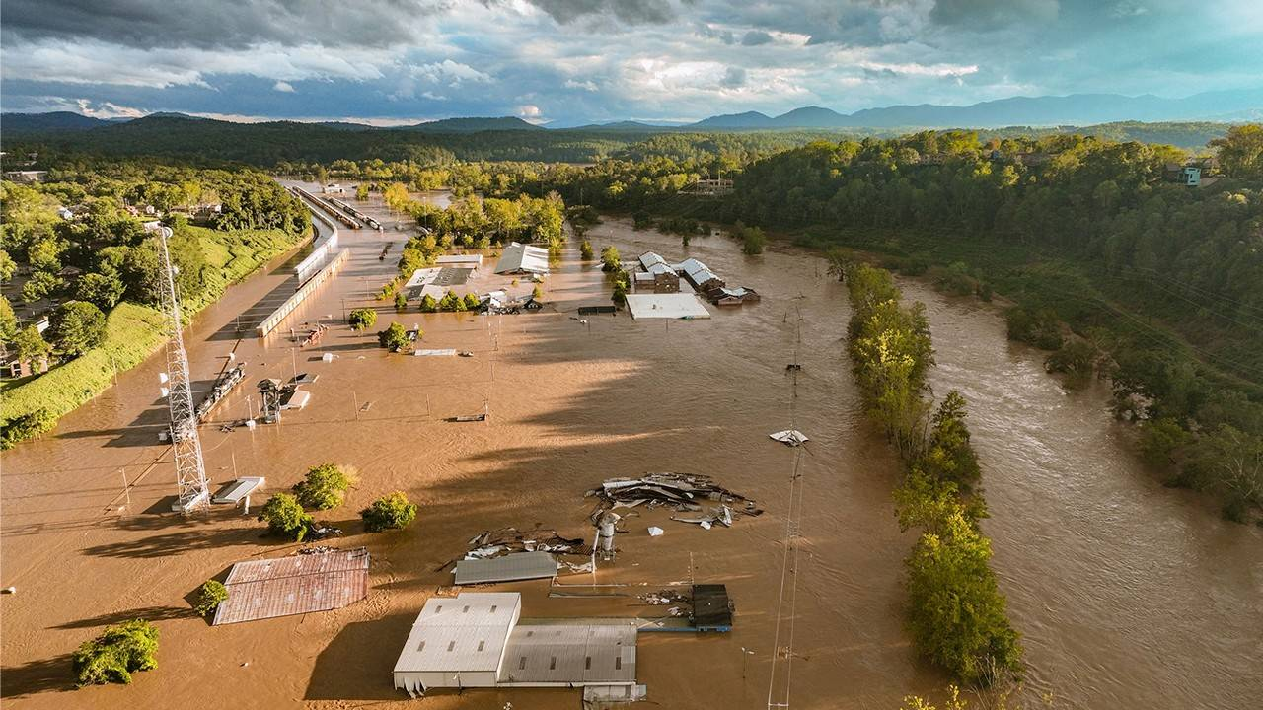

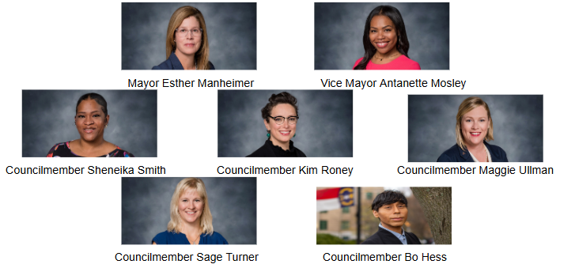
Asheville City Council
Photo by Stephan Pruitt/American Red Cross

Slide 3
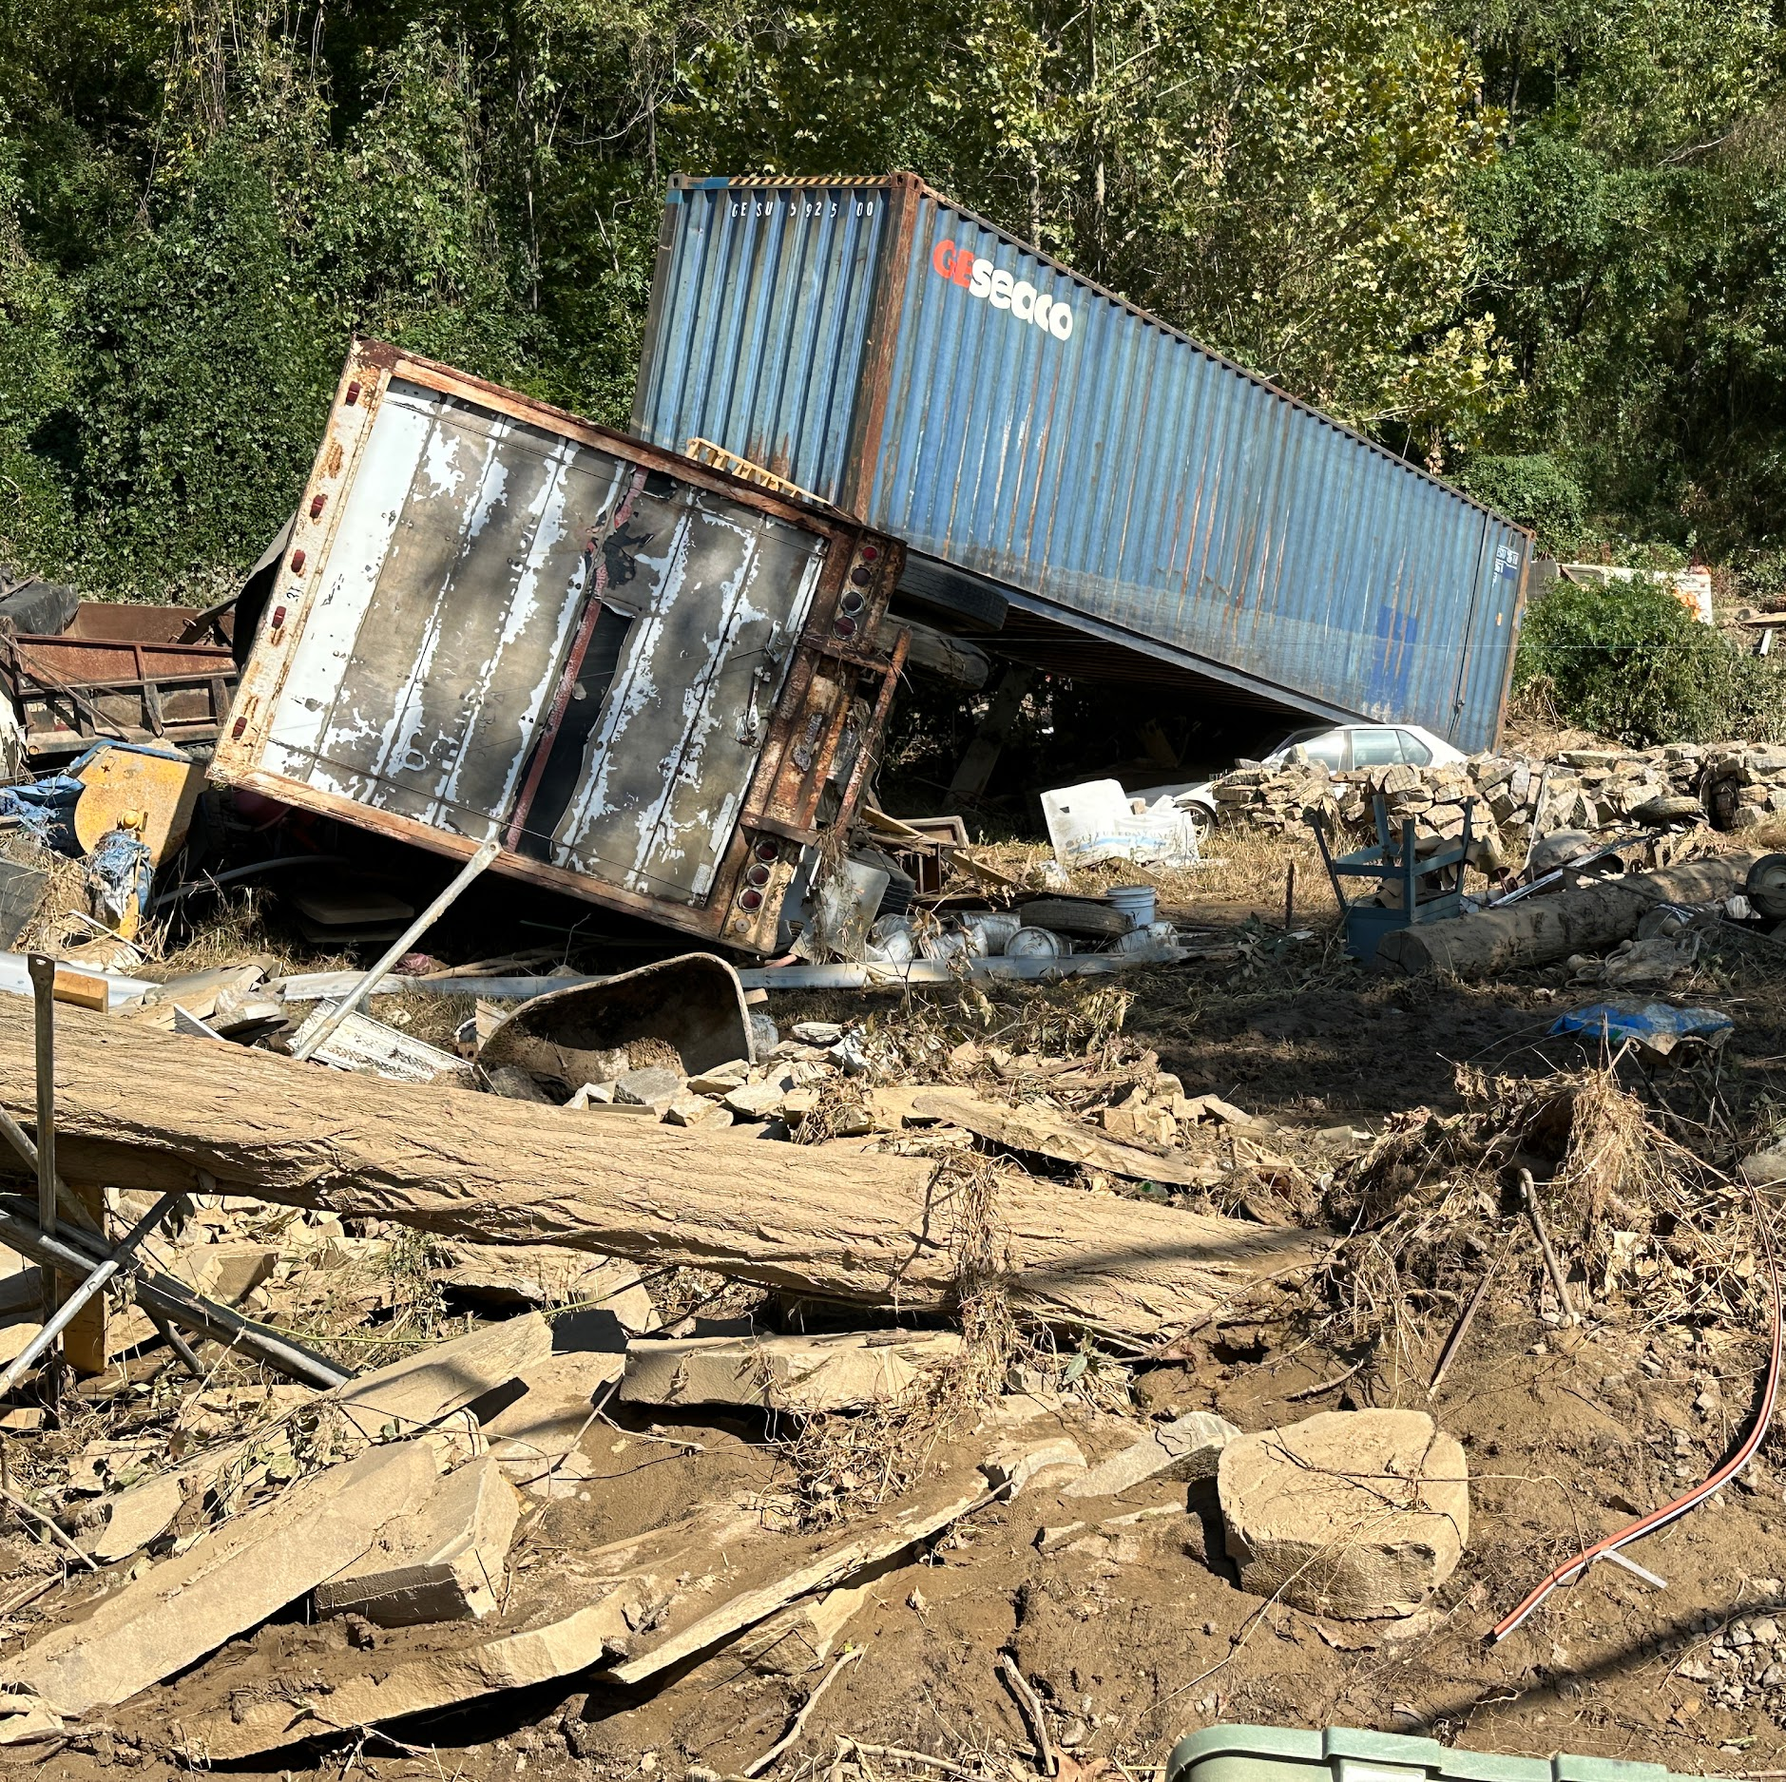
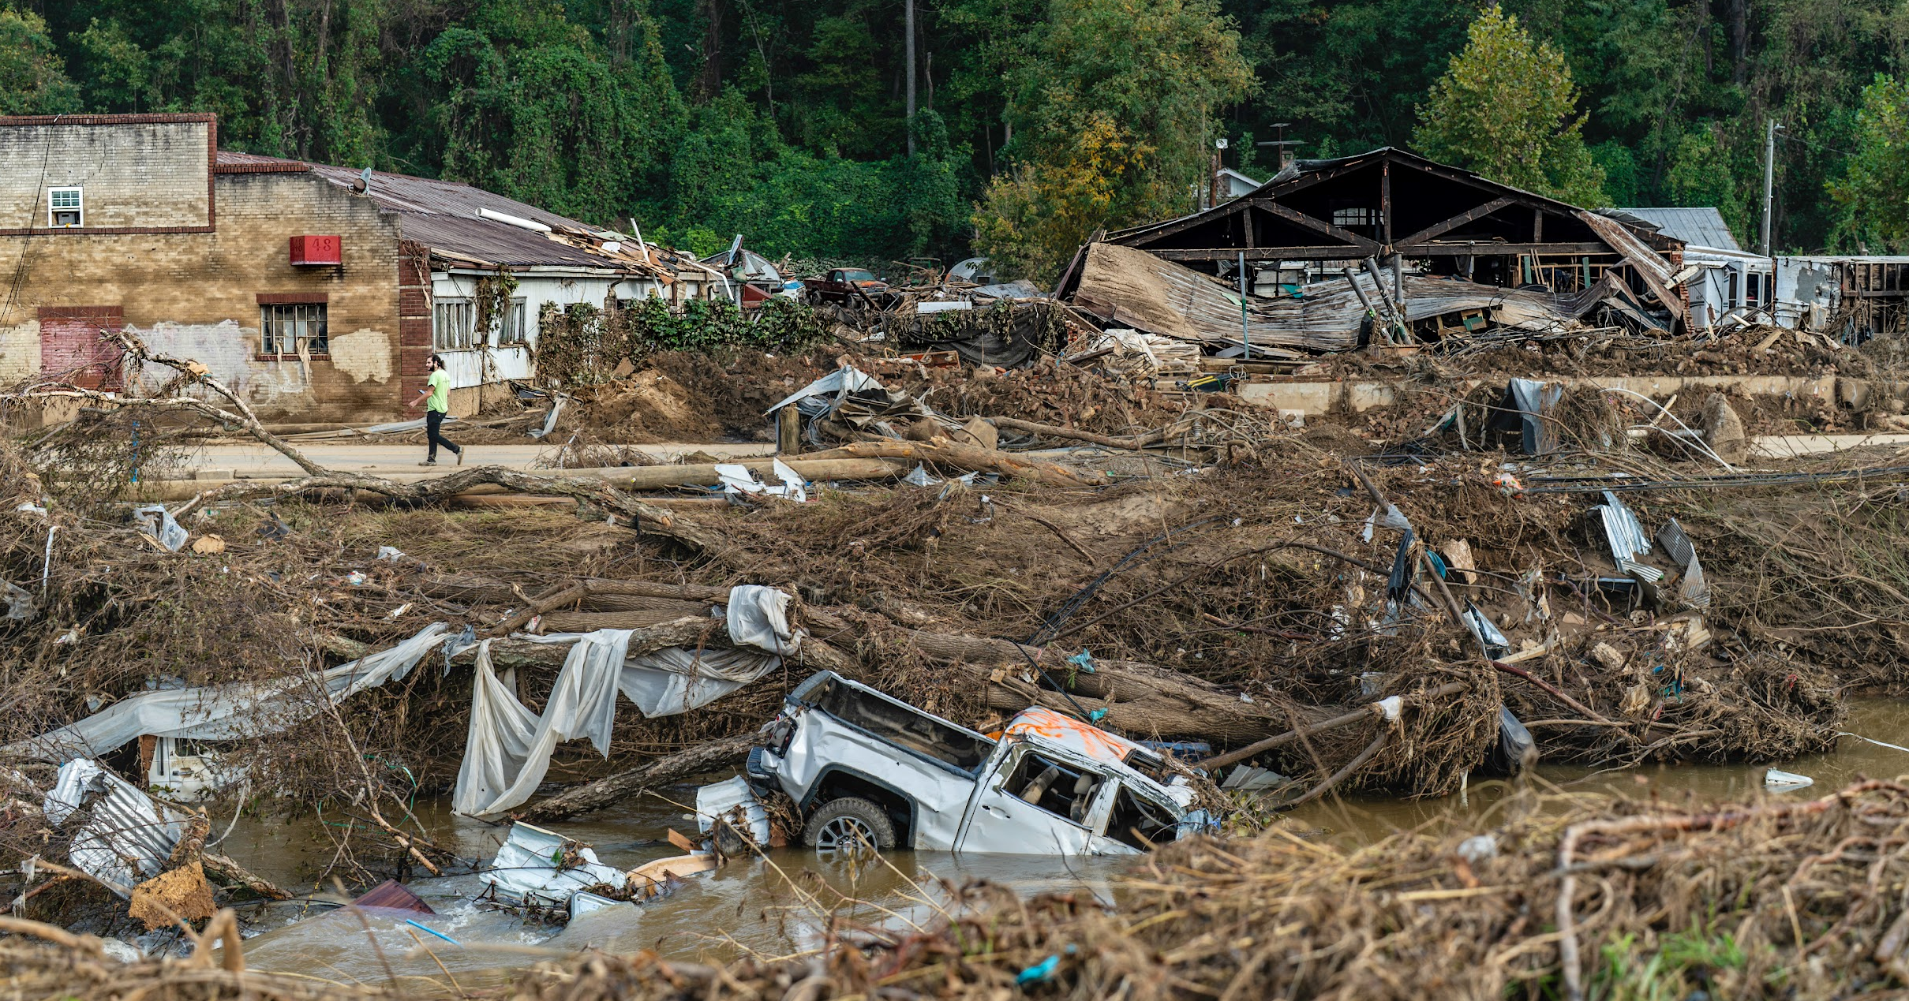
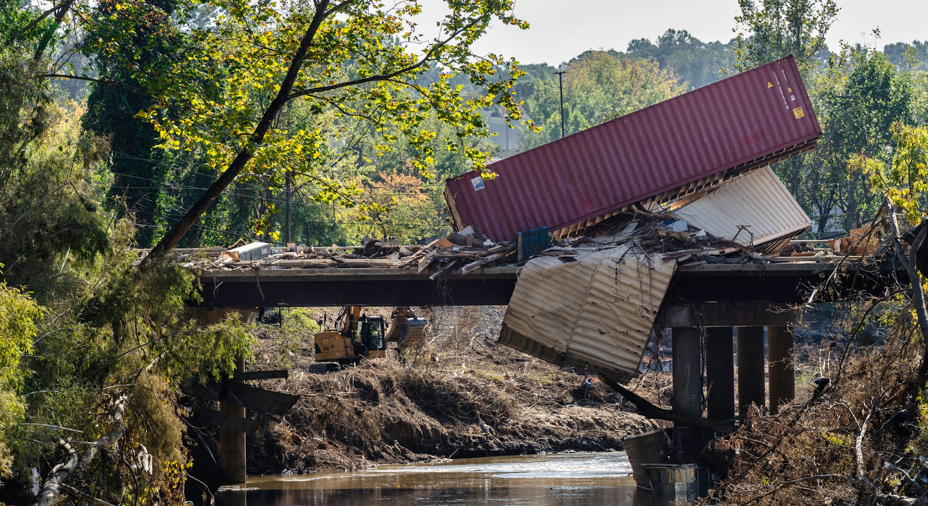

Slide 4
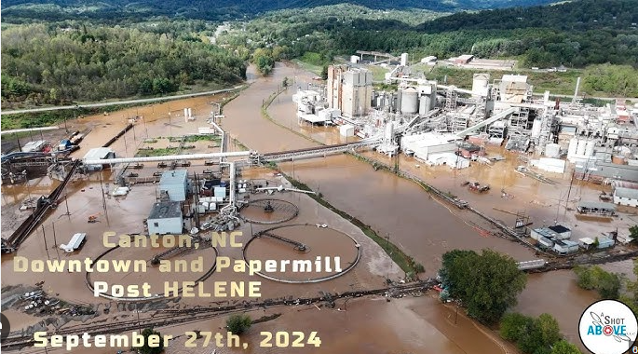
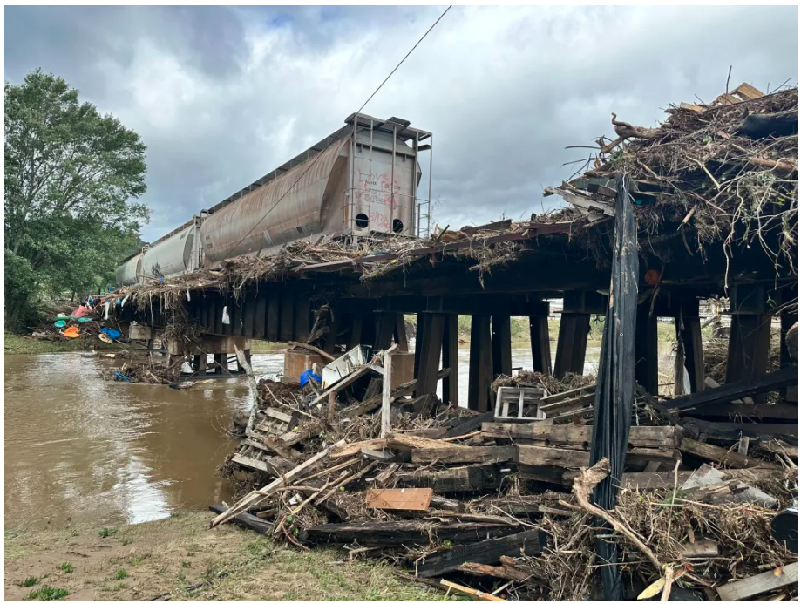
Canton, NC

Slide 5
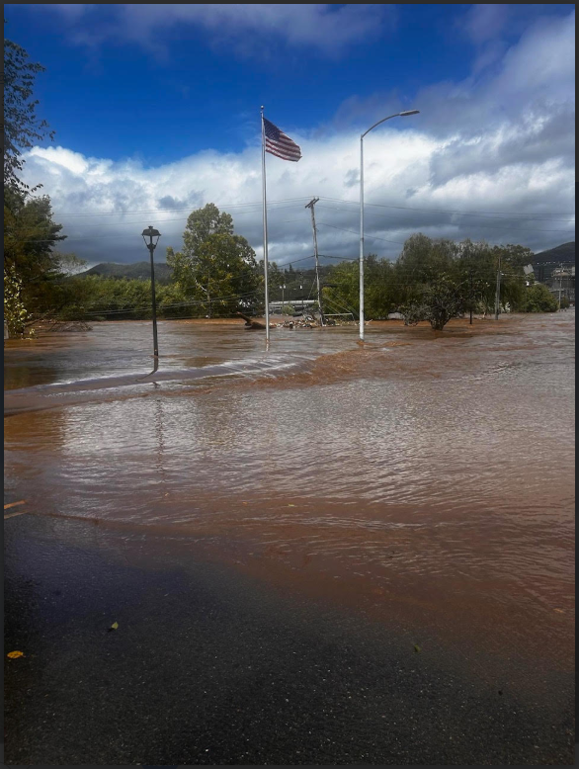
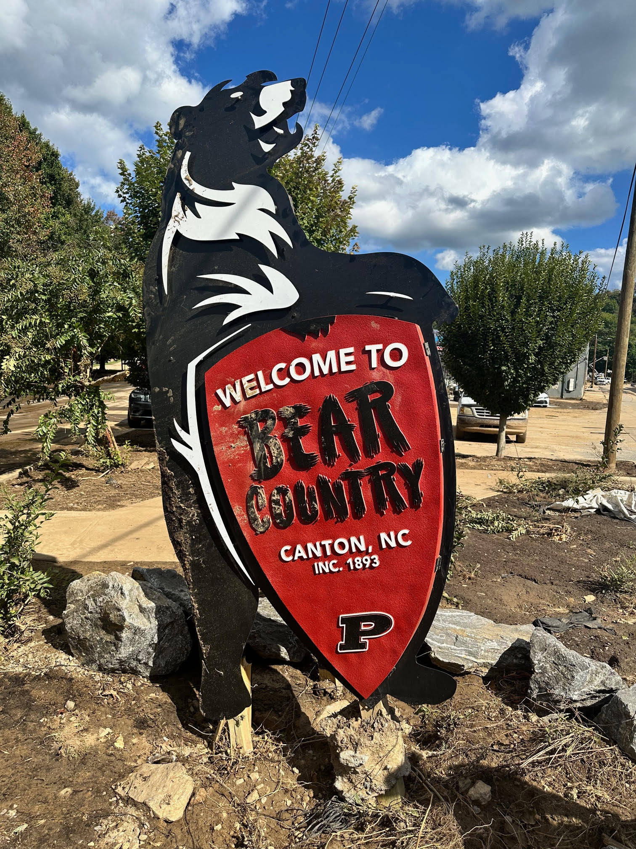
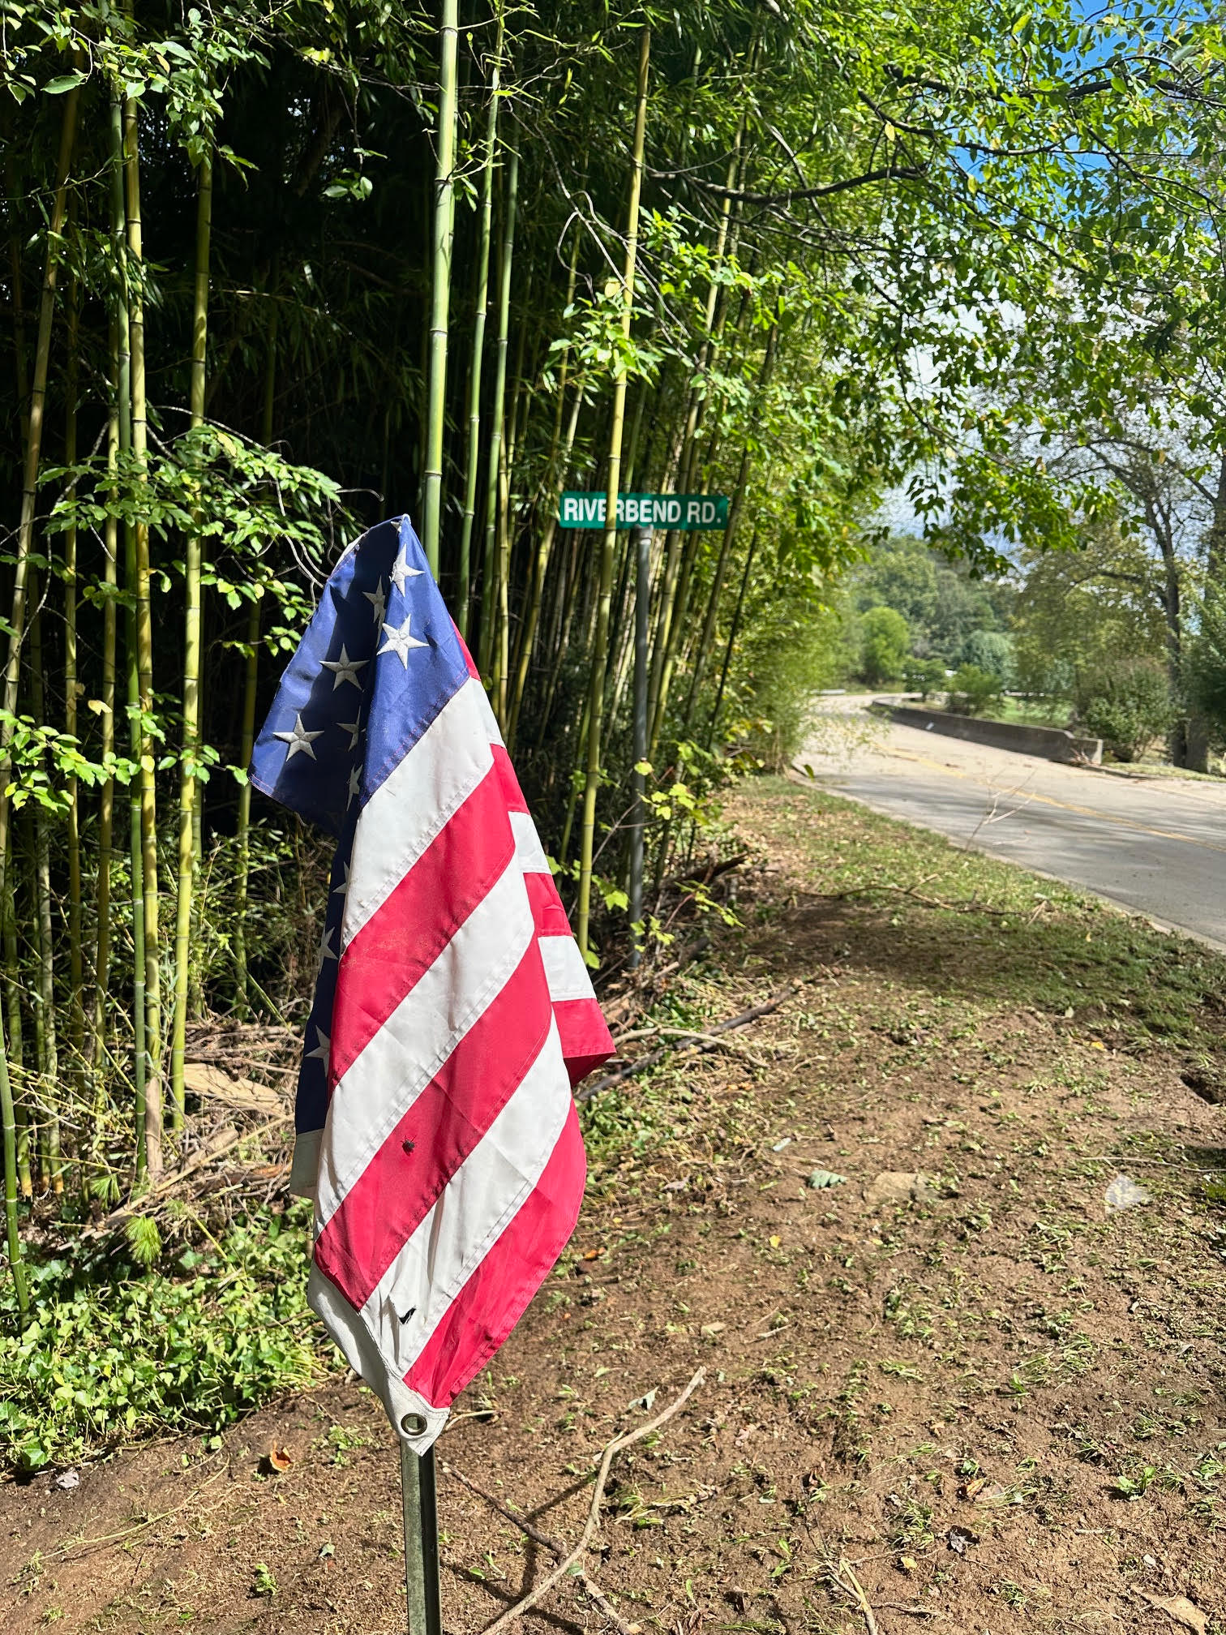


Slide 6
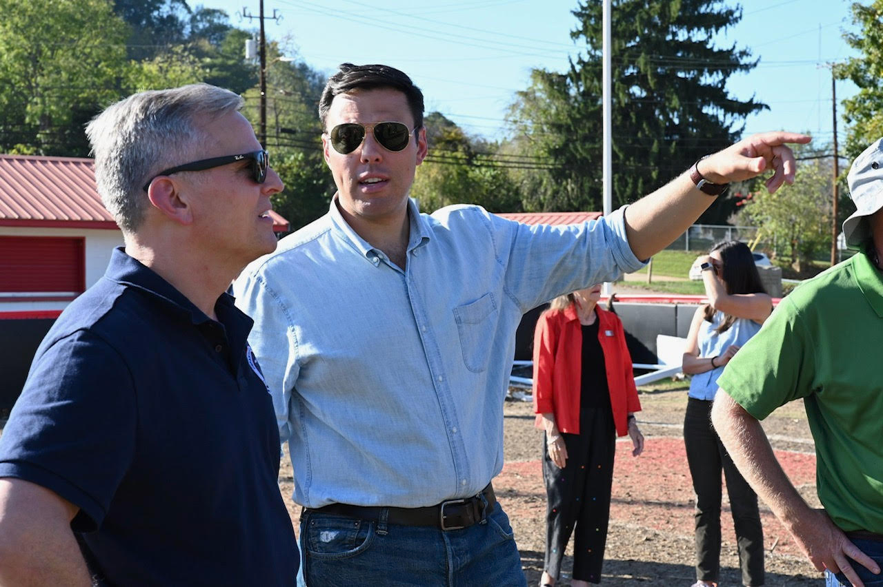
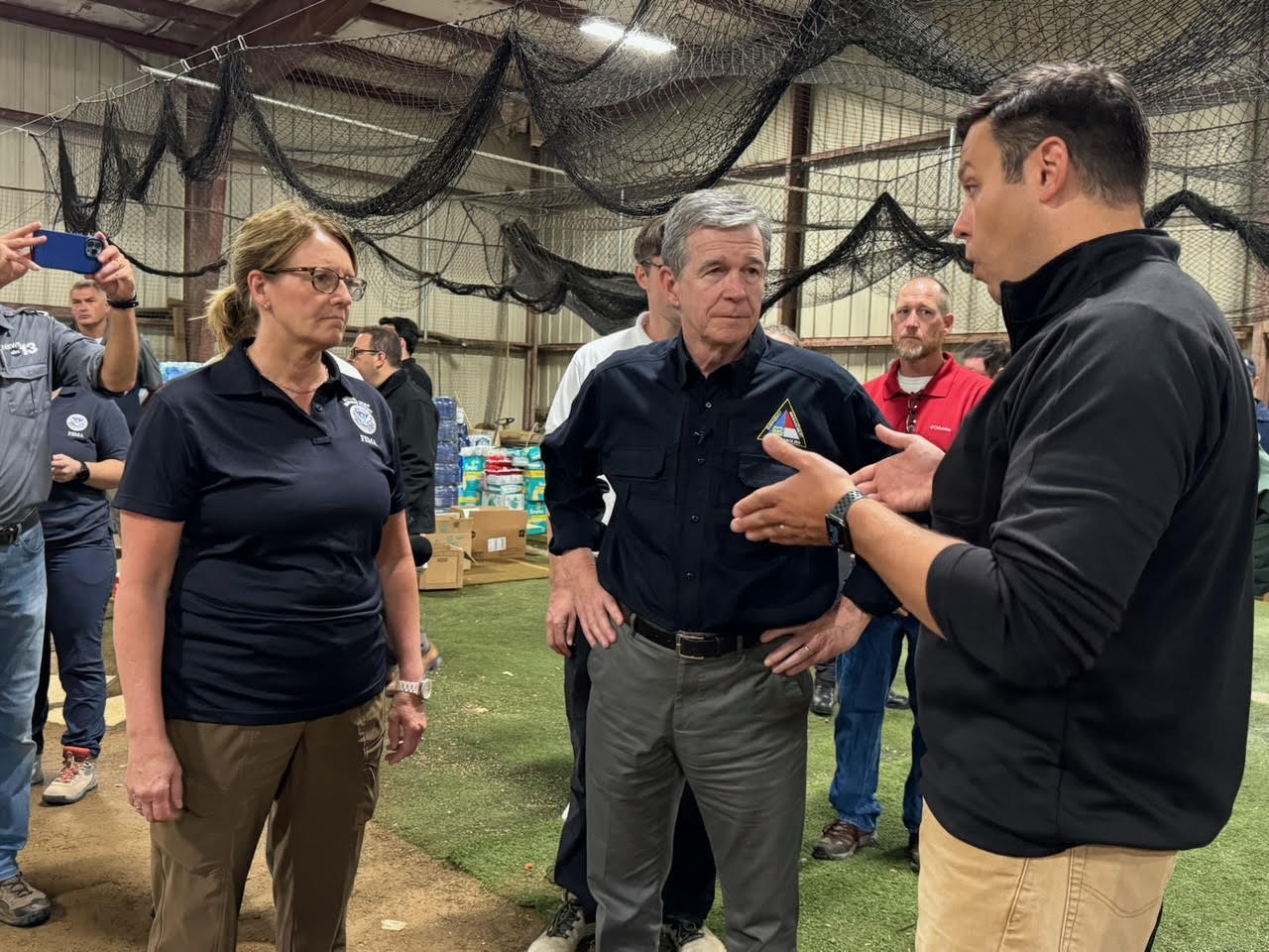
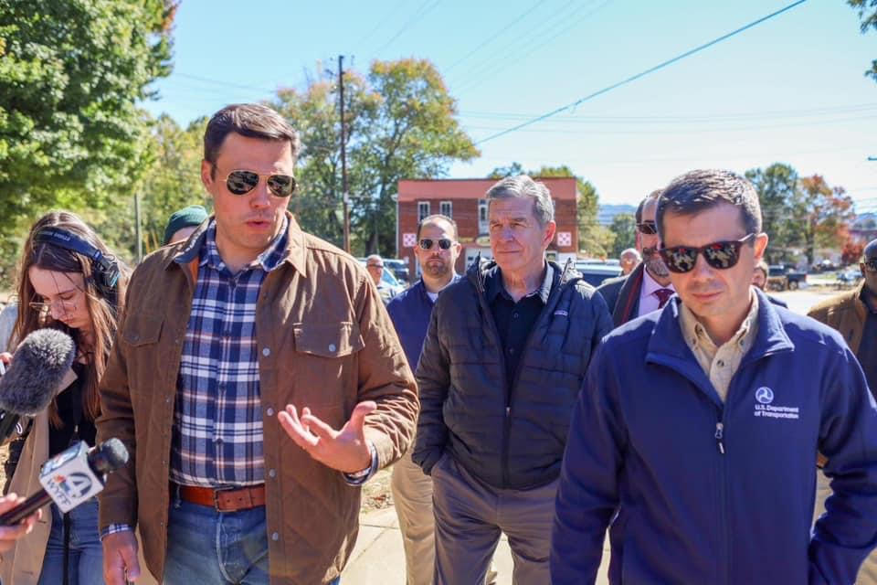

Slide 7
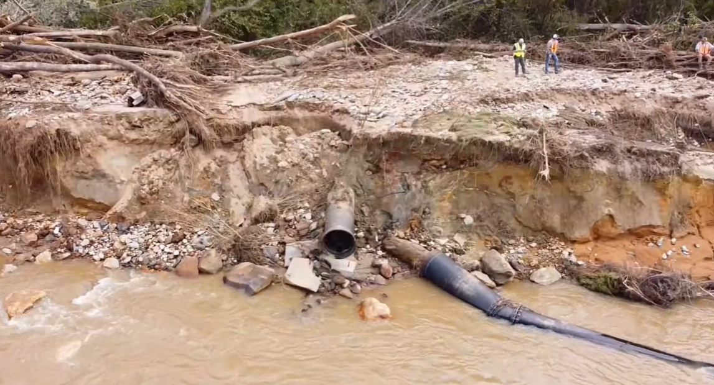
North Fork 36” Bypass Waterline
SEP 30

Slide 8
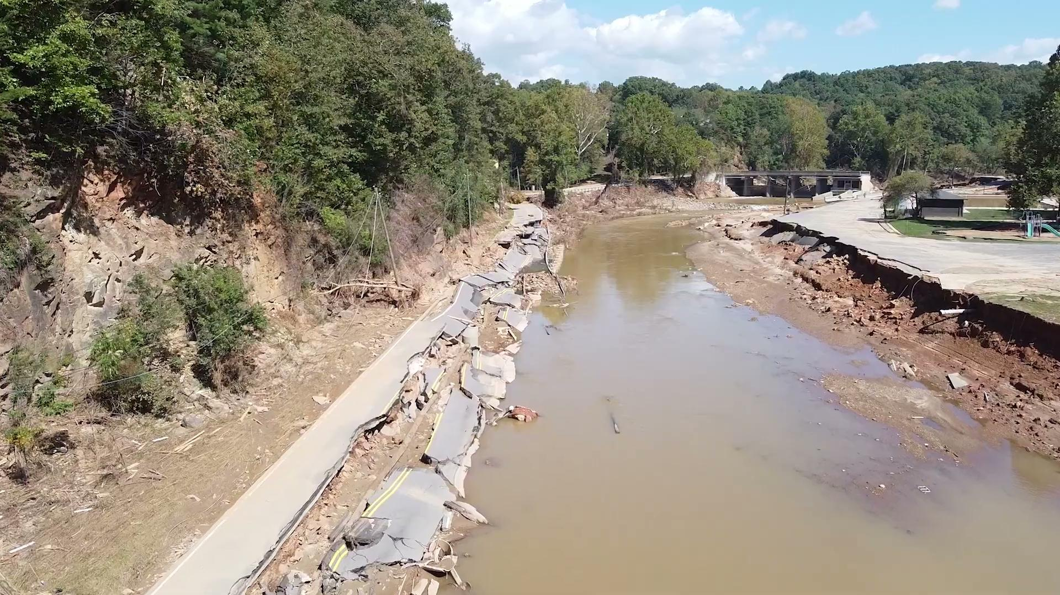
Swannanoa River Road
OCT 5

Slide 9
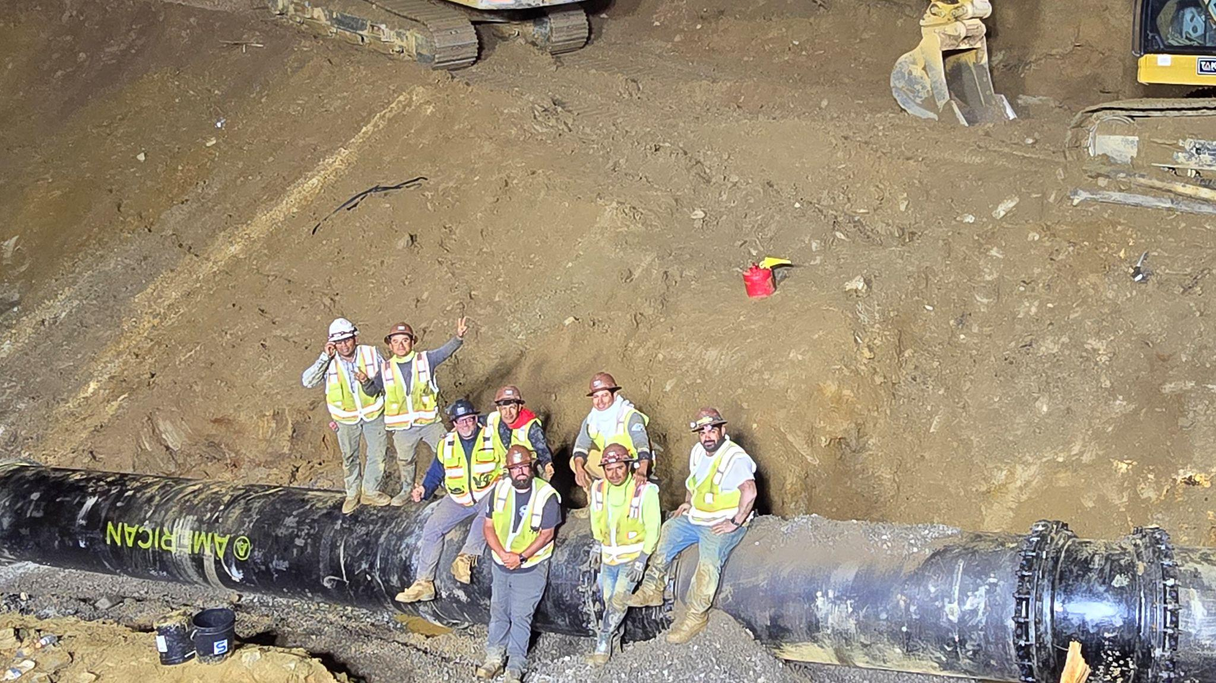
North Fork 36” Bypass Waterline Completion
OCT 10

Slide 10
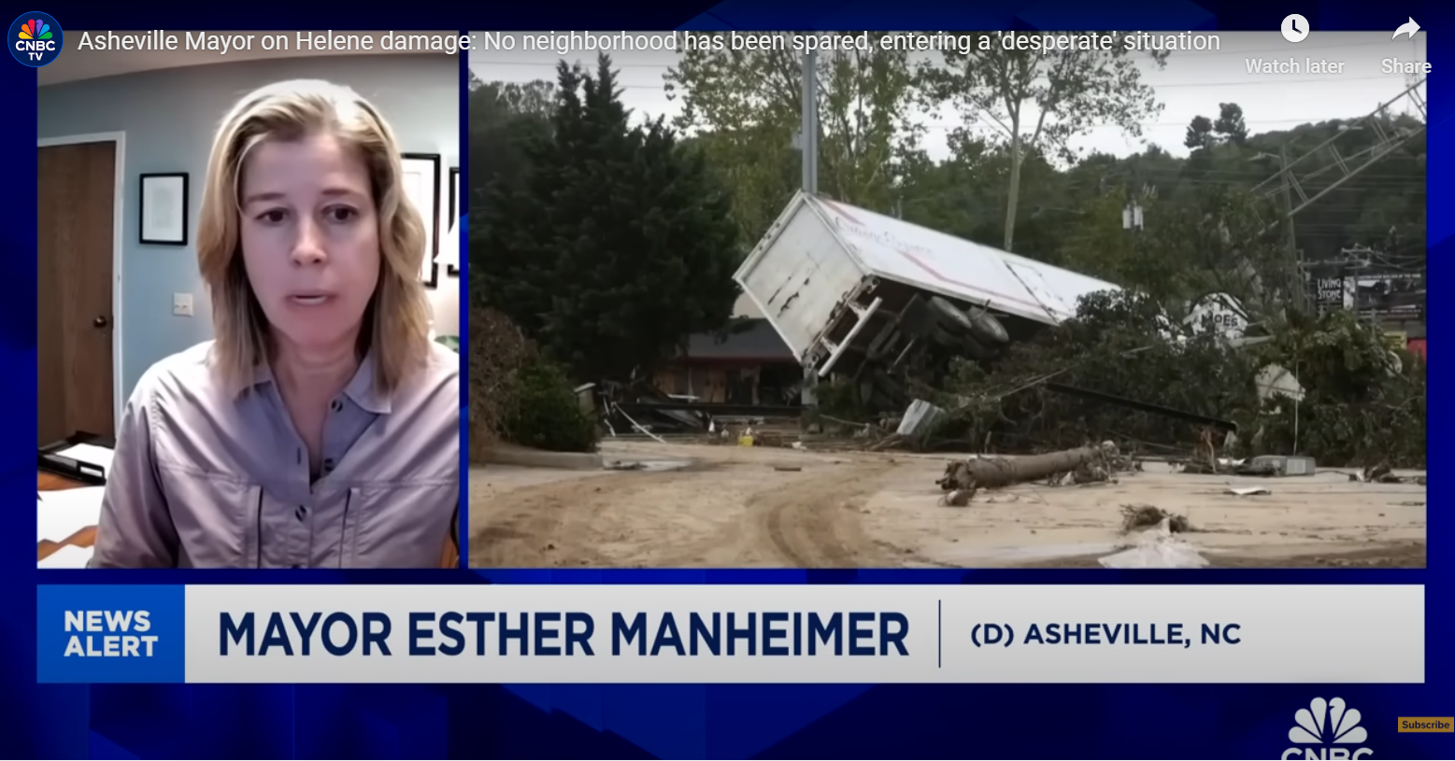
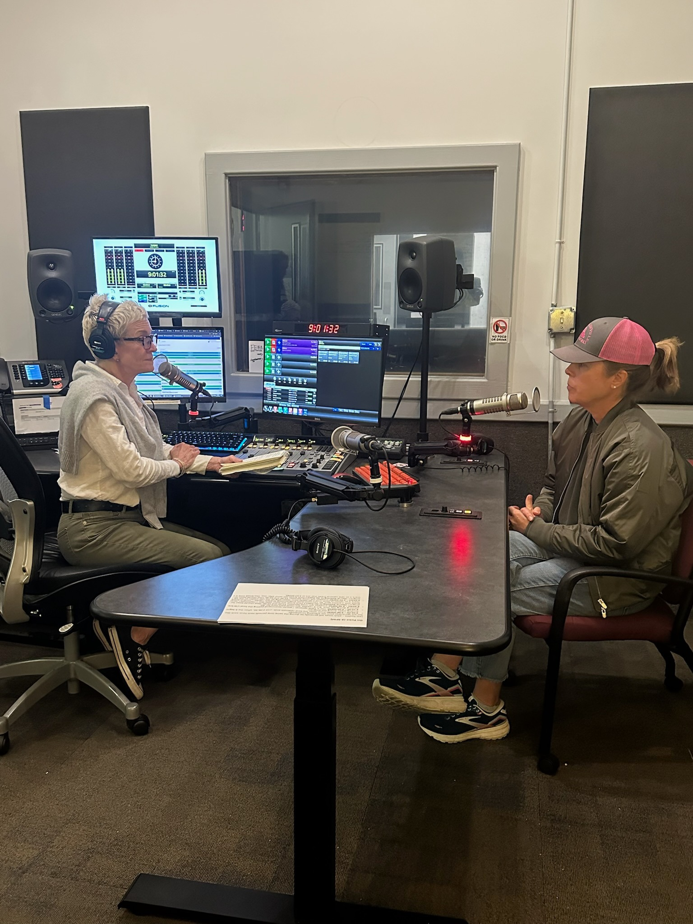
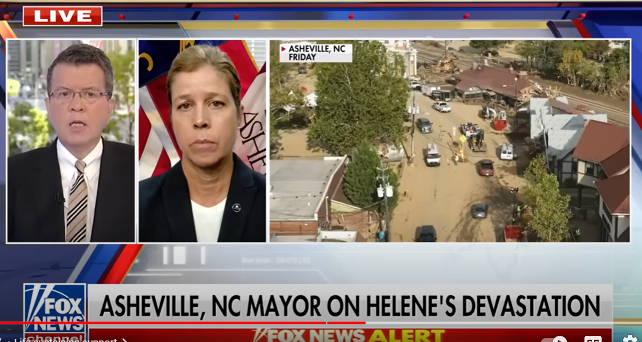
Notes:
Transition to Response: Media, national to local

Slide 11
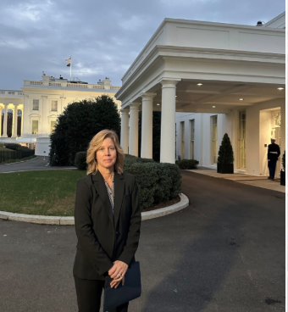
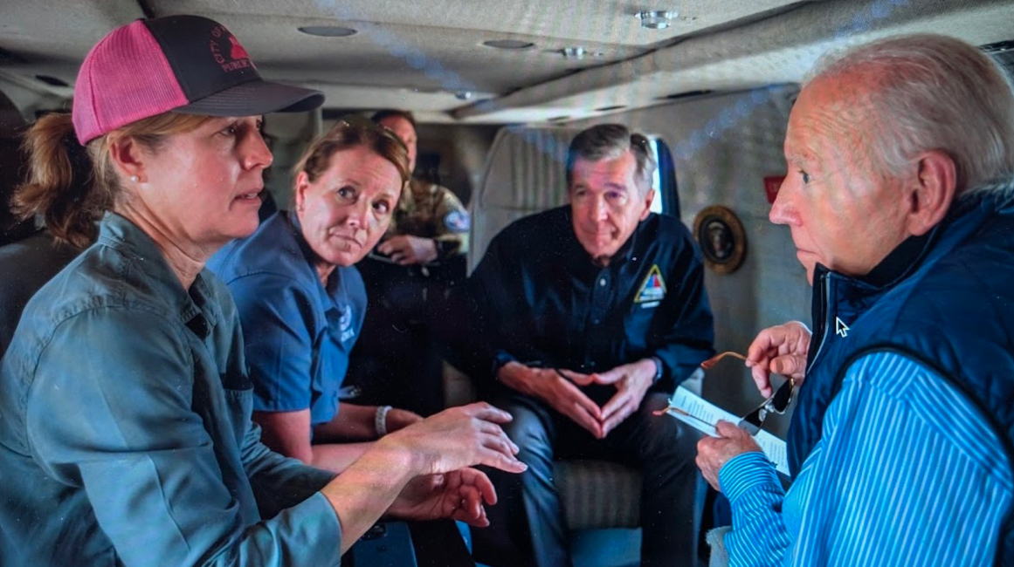
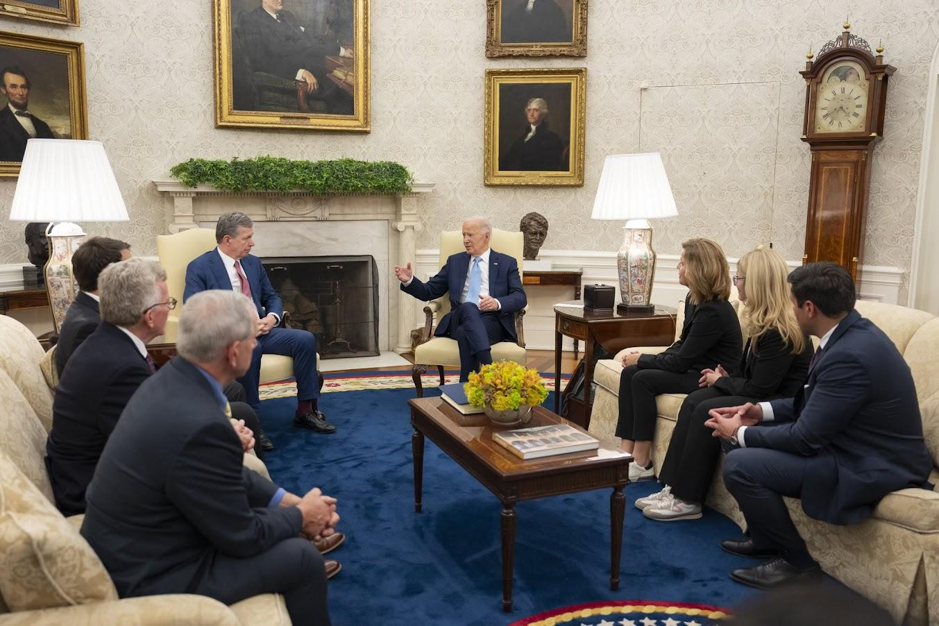

Slide 12
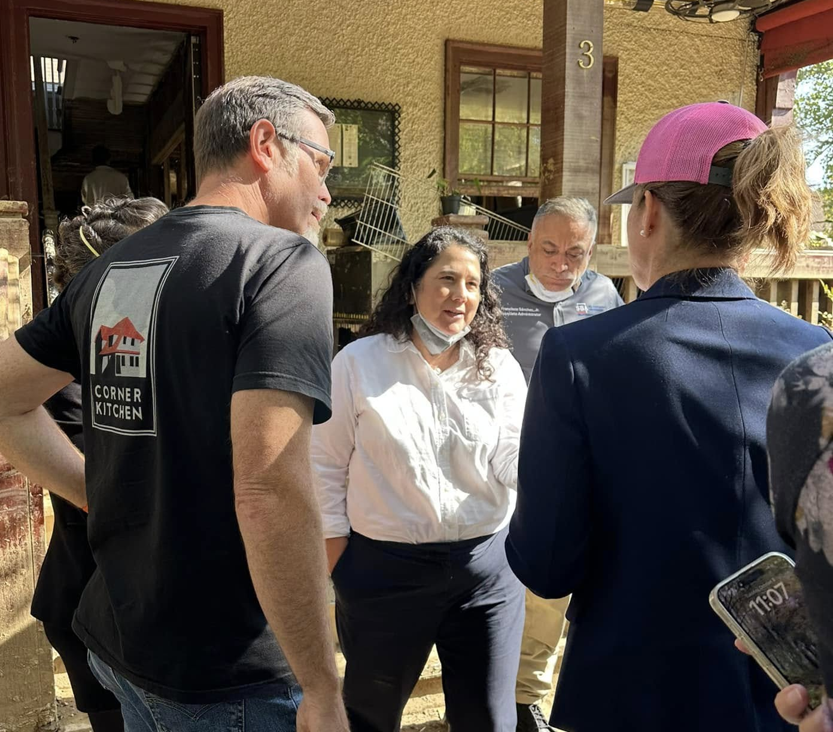
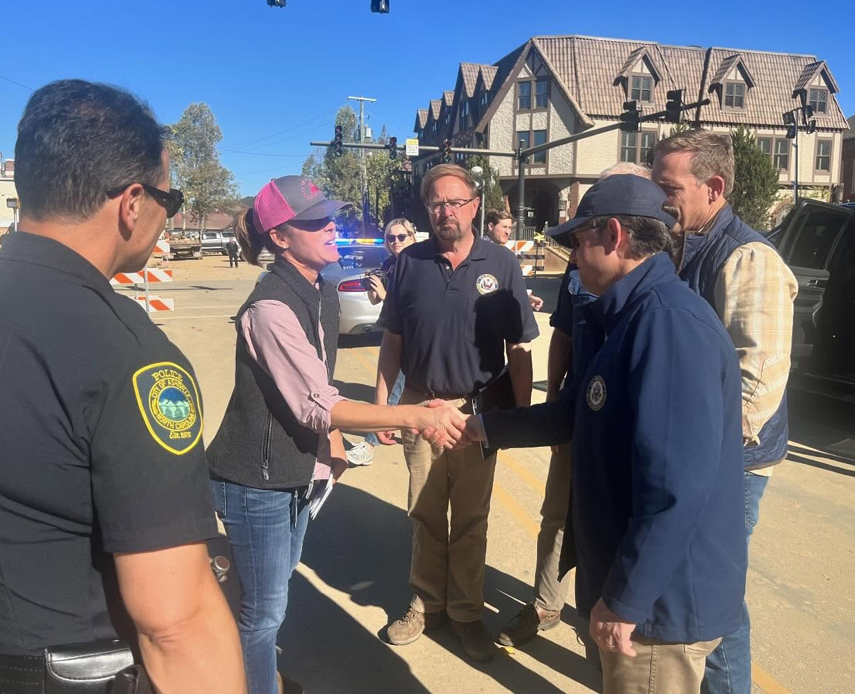
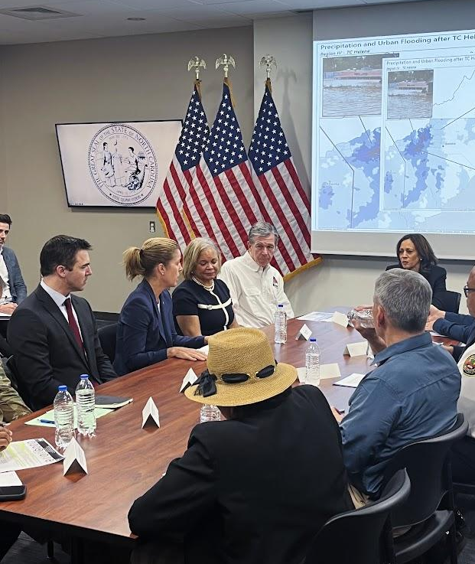
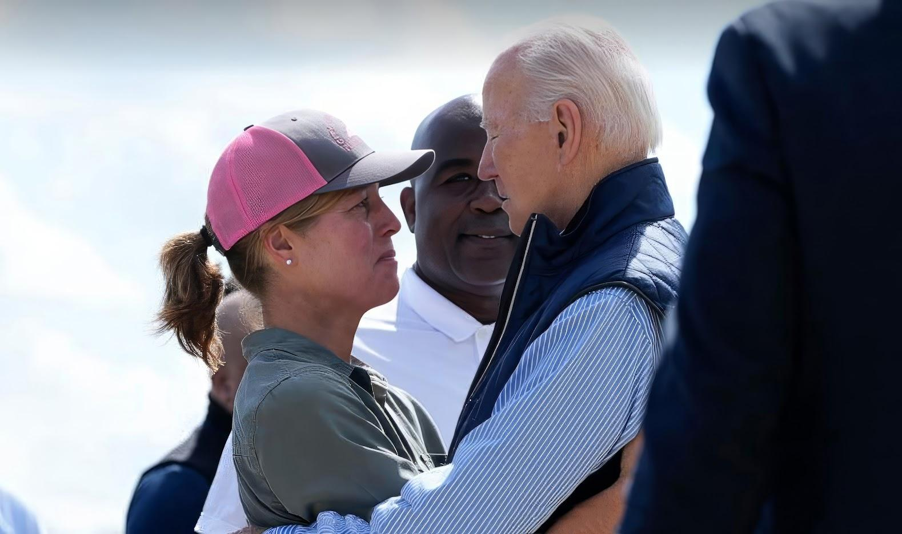
Notes:
Fed and Leg visits

Slide 13
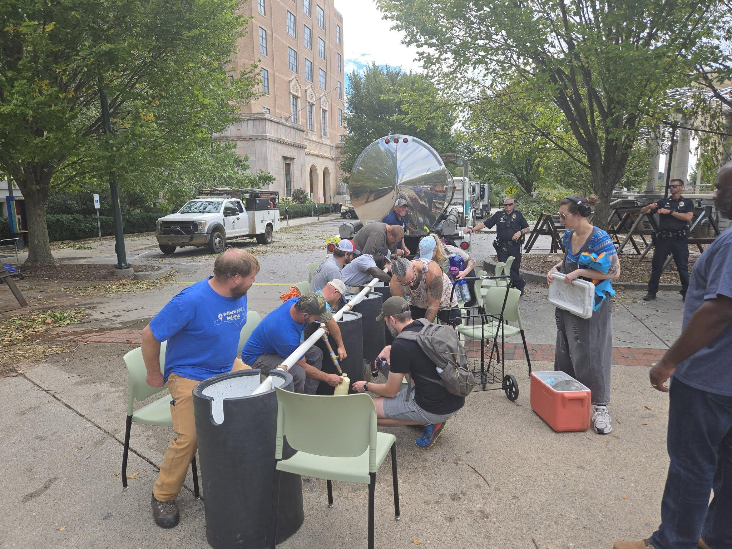
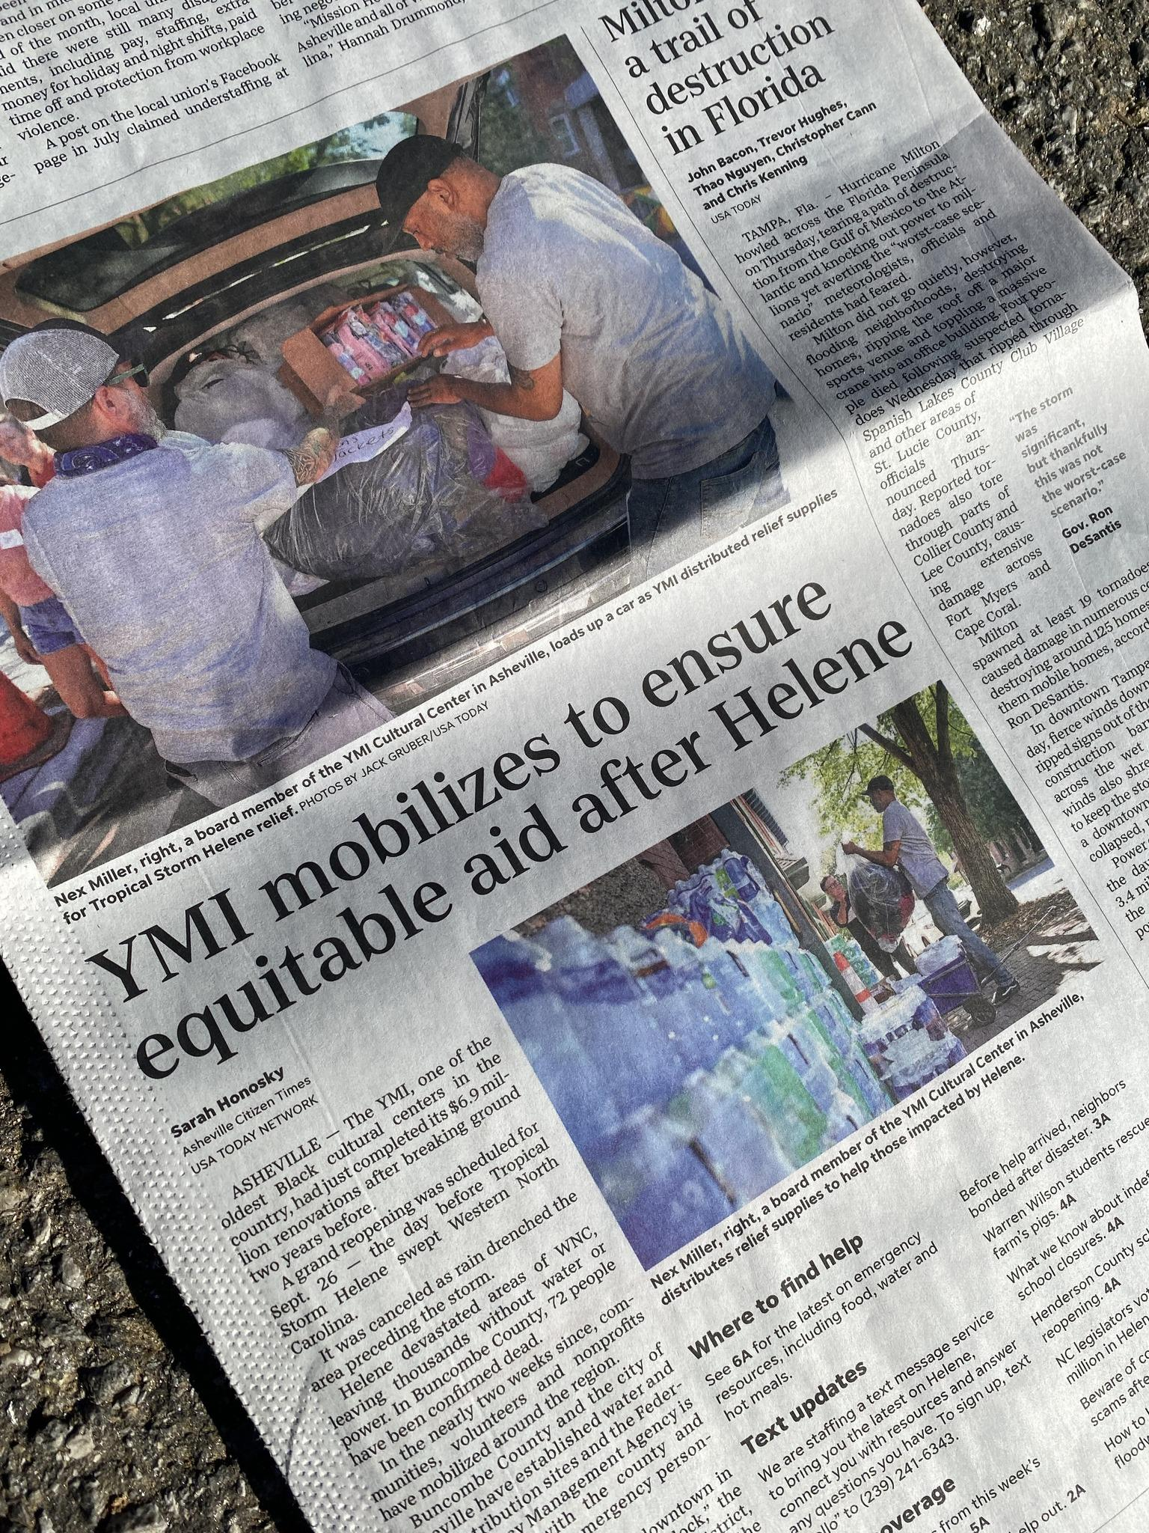
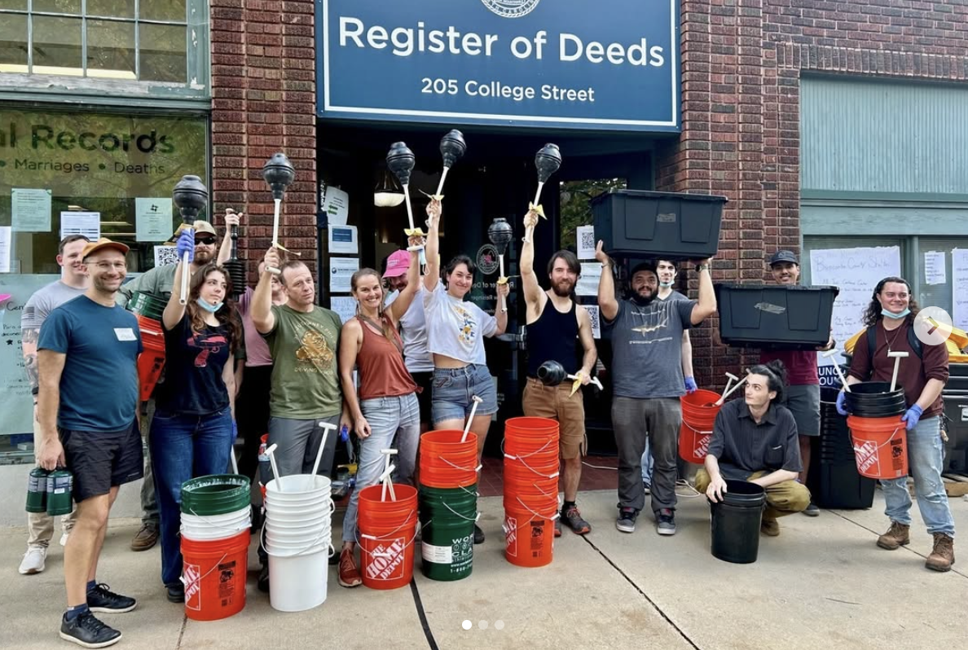
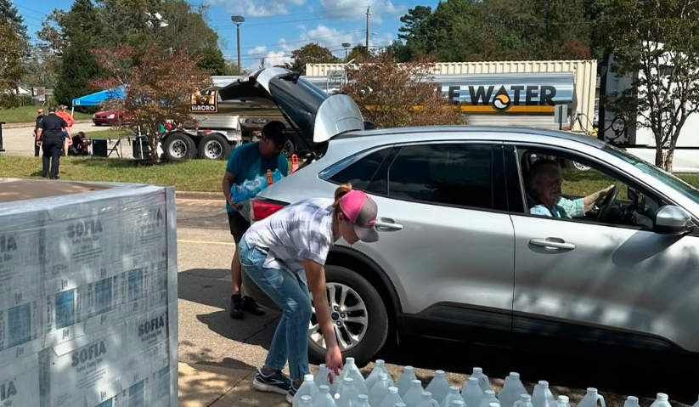
Community Recovery in Action
Water Distribution at Pack Square and Shiloh
Wellness Check volunteers
Credit: Buncombe County Government
Bridging the Gaps supply distribution
Credit: YMI Cultural Center

Slide 14

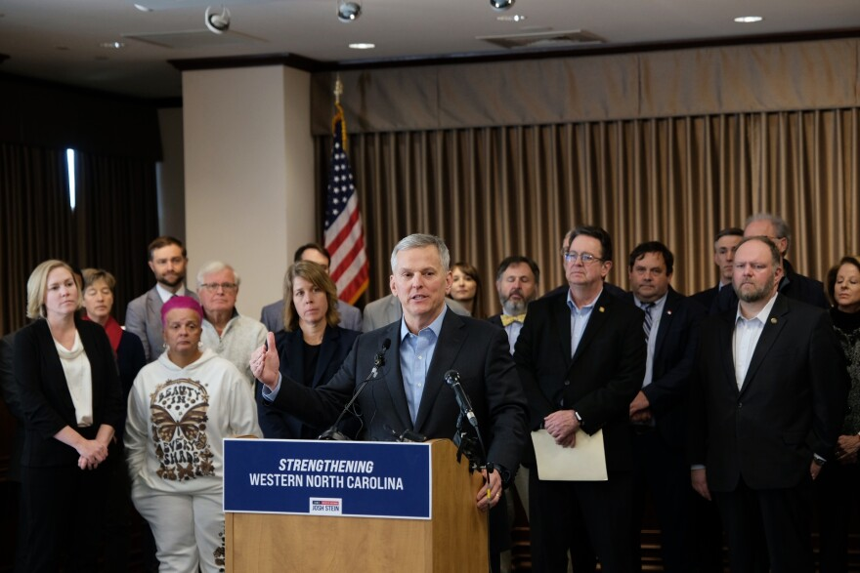
Governor’s Advisory Committee on WNC Recovery
Since January 2025, GROW NC has worked across state agencies and with local, state, federal, and nonprofit partners to accelerate recovery in western North Carolina.
Interstate 40 reopened to traffic on Saturday, March 1st
The WNC Small Business Initiative has funded 989 loans for small business owners impacted by Helene
For more information on progress made, visit WNCRecovery.nc.gov

Slide 15
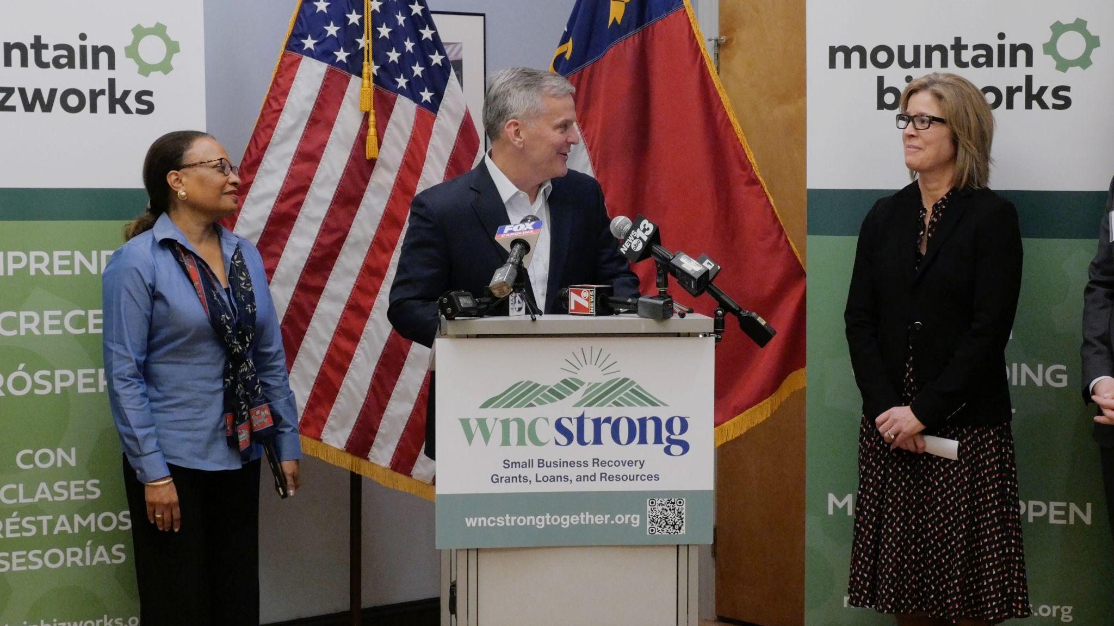
CDBG-DR Action Plan Approved
HUD approved Asheville’s $225M Action Plan for Community Development Block Grant - Disaster Recovery (CDBG-DR) funds
Funding Breakdown
$125M - Infrastructure
$52M - Economic Revitalization
$31M - Housing
$11.2M - Administration
$3.7M - Planning
$2M - Public Services
Left to Right: HUD Acting Secretary Adrianne Todman, Governor Josh Stein, Mayor Esther Manheimer. January 7, 2025
Notes:
Next Steps - HUD certification is underway and the first programs are expected to launch in the fall of 2025
C

Slide 16
September 2024 -The City of Asheville (City) was severely impacted by Tropical Storm Helene (DR-4827-NC)
January 2025 - HUD allocated $225,010,000 to the City in CDBG-DR Funds. The City distributed the Helene Recovery Priorities Survey
February 2025 - The City held six community engagement sessions.
March 2025 - The City published a Draft Action Plan, opened a public comment period, and hosted three public feedback sessions. The Administrative Grant Agreement was signed on March 3, marking the City’s CDBG-DR Award Start Date. On March 19, HUD issued revisions to the UN requiring edits to the Draft Action Plan.
May 2025 - On May 14, 2025, HUD approved the City’s CDBG-DR Action Plan.
June & July 2025 - The City worked to draft HUD-required guidelines, policies and procedures, and coordinated with HUD on the Financial Management and Grant Compliance Certification.
August 20, 2025 - The CDBG-DR Grant Agreement was signed.
October 2025 - Onboarded implementing partner for staff augmentation. Publication of initial four Program Manuals. See Program pages for further details!
March 2, 2031 - CDBG-DR Award end date.

Slide 17
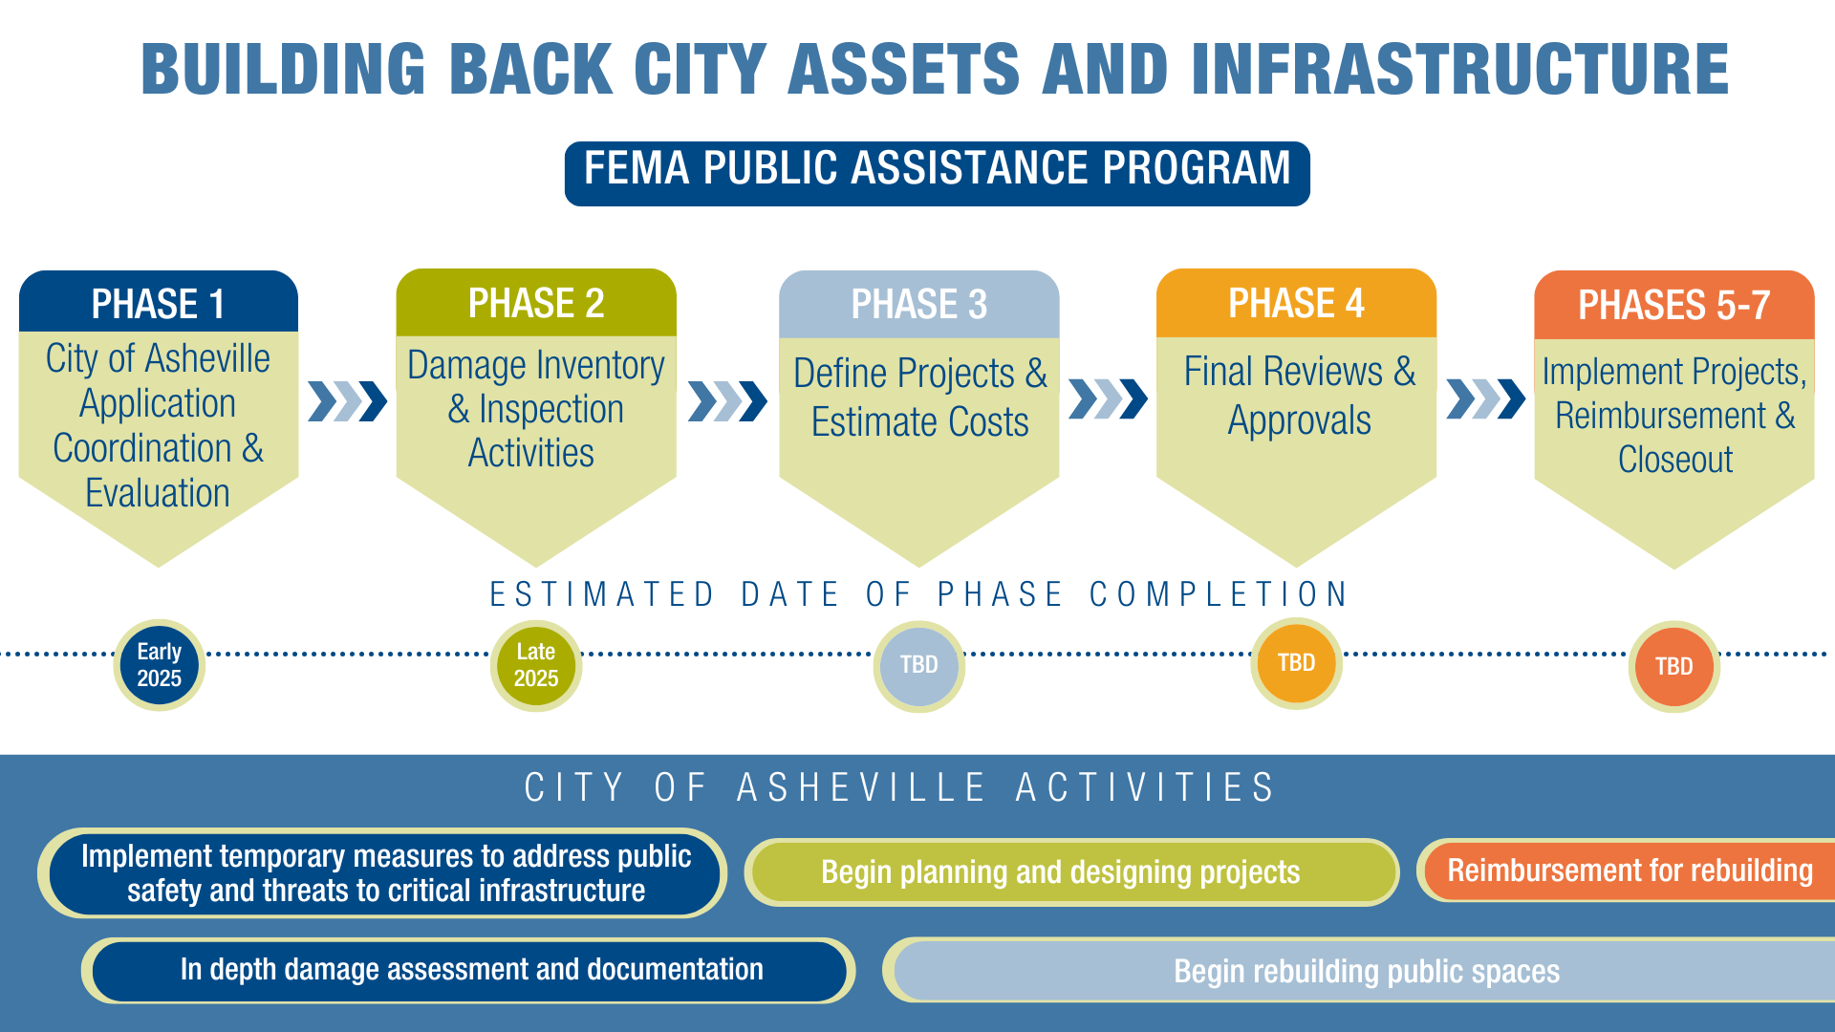
Notes:
City is currently working throught phases 2 and into 3 of the FEMA process.

Slide 18
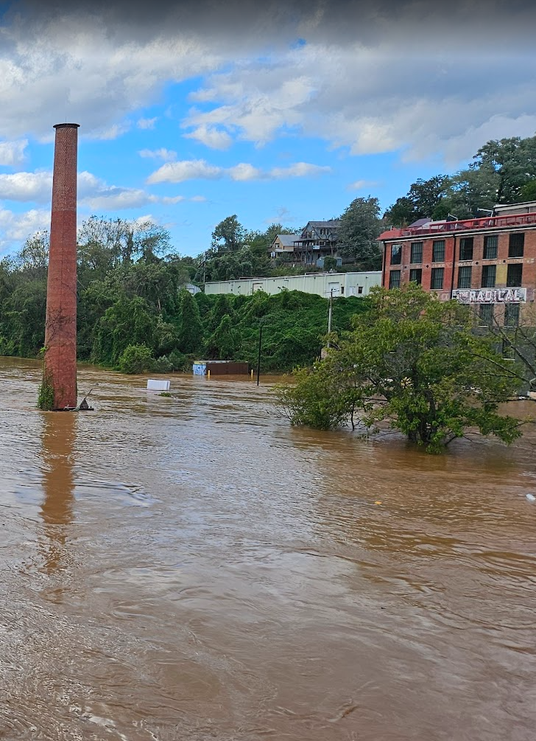
Hazard Mitigation Grant Program (HMGP)
FEMA funds administered by the State
HMGP is competitive with $1.4 billion allocated across North Carolina for Helene, with priority given to affected counties
Private property owners may apply for elevation, stabilization, and/or acquisition funding
Public infrastructure projects must mitigate a natural hazard, and construction activities must prove cost effectiveness
Nine infrastructure project applications were authorized by City Council at the July 26, 2025 meeting. Additional projects may come forward at future Council meetings.

Slide 19
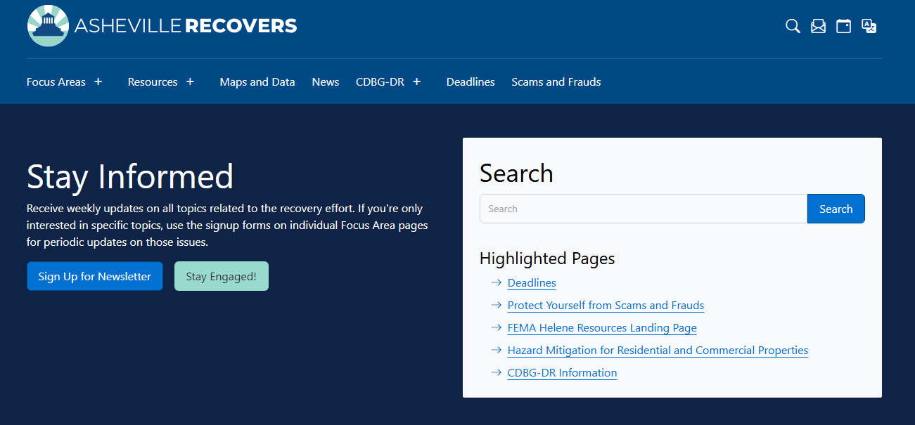
City of Asheville Recovery

Slide 20
